Slide 1
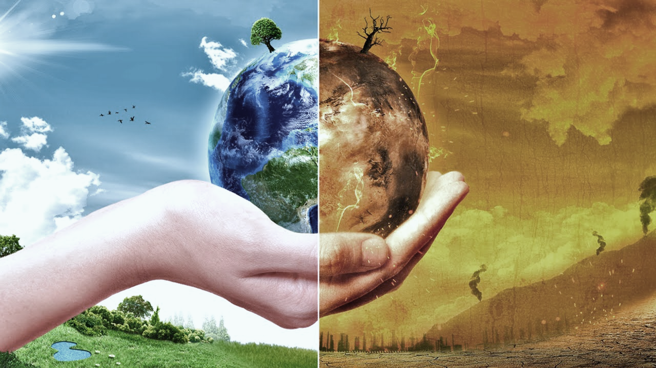

How do we decide
Whether to vaccinate our children?
Eat genetically modified foods?
Accept human causes of climate change?
Gail Sinatra
Understanding Scientific Information
This webinar presents some of the challenges members of the public face when grappling with understanding science, such as overcoming misconceptions, deciding who to trust as a source of scientific information, and resolving competing knowledge claims. Dr. Gale M. Sinatra is the Associate Dean for Research and Professor of Psychology and Education at the Rossier School of Education at the University of Southern California. Sinatra will discuss her work with Division 15 member, Barbara Hofer on how educators, media specialists, and scientists might help address these challenges. Open to everyone!
Friday September 15th, 2017: 12-1pm, EST
Location: Teachers College 518 for a group viewing. Light refreshments will be served
For more information or to register for viewing on your own, please visit
espace.bsu.edu/rds/gailsinatra
A Research Cooperative
espace.bsu.edu/rds
Notes:
v2

