Slide 1
Community Engaged Research Design
October 18, 2019
Jim Connolly, George and Frances Ball Distinguished Professor, History
Jerrell Cassady, Chair and Professor, Educational Psychology
Jennifer Wies, Director for Assessment and Accreditation and Professor, Anthropology

Slide 2
Objectives
Identify working definitions/ideologies for community engaged scholarship
Share examples of community engaged scholarship
Identify challenges and opportunities for community engaged scholarship

Slide 3
We engage students in educational, research, and creative endeavors that empower our graduates to have fulfilling careers and meaningful lives enriched by lifelong learning and service, while we enhance the economic, environmental, and social vitality of our community, our state, and our world.

Slide 4
Introductions
What do you bring?
What do you wish to take away?

Slide 5
Community-Engaged Scholarship Figure
(Doberneck et al, 2017)
…your experiences with community engagement, which, then in turn…
academic audiences
Scholarship informs your understanding and guides…
…generate new scholarship and practice for both…
public audiences.
In Collaboration with Community Partners (including local, indigenous, or practitioner knowledge)
Notes:
Remind them at that in Seminar One, we learned about foundational scholarship
Types of community engaged scholarship
Community, community partners
NEEDS Accessibility

Slide 6
Community. Engaged. Scholarship.
Community
  Contexts
  Histories
Engaged
  Projects and People
  Involvement and expectations
Scholarship/Research/Creative Endeavors
  Definitions and rigor
  Research team representation
  Methodological expertise and capacity
Notes:
Communities- Dobernick
Geographic
Affiliation or interest
Identity
Circumstance
Profession or practice
Faith
Family/Kin
And possible intersectionality among communities
Engagement- Dobernick
Academic work done with the public.
Inclusive, collaborative, problem-orientated
Multi-directional flow of knowledge
Co-creation of knowledge (e.g., both universities and communities together create solutions)
Shared authority for knowledge creation (e.g., both universities and communities have relevant knowledge)
University as part of an ecosystem of knowledge production addressing public problem solving
Community change that results from the co-creation of knowledge (adapted from Saltmarsh & Hartley, 2011, p. 22)
Foundational Scholarship
…theories, conceptual frameworks, and best practices that inform and guide your community engagement. Foundational scholarship may include scholarship about:
About the issue of concern
Disciplinary Theories or models
Scholarship of Engagement (SoE)
Scholarship of Teaching and Learning (SoTL)
Population, Community, Context, or Setting
Paradigms, Methodologies, or Approaches
Collaboration Techniques, Engagement Processes, or Methods
Reflection, Evaluation, Assessment, or Lessons Learned
Or any combination

Slide 7
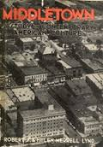
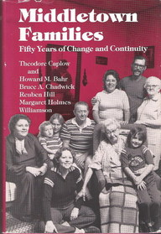
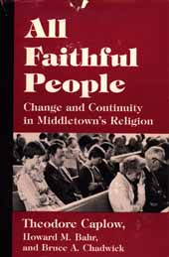
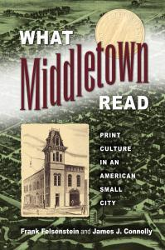
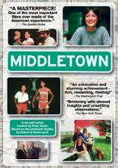
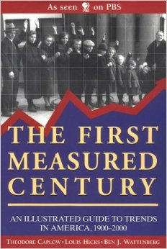
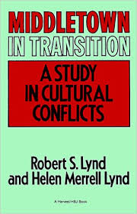
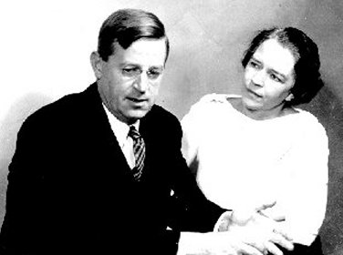
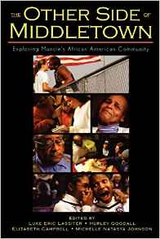
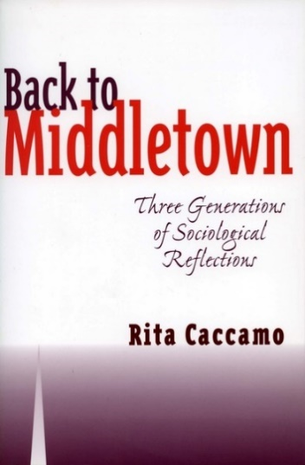
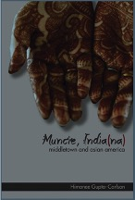
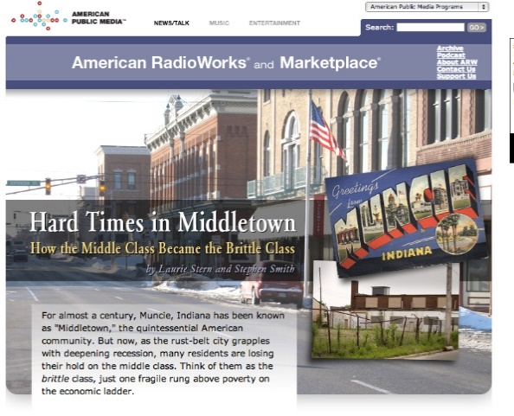
Muncie as Middletown, 1929-
Notes:
Middletown—captures national attention in 1929; inaugurates a tradition; flawed.
Makes Muncie most studied American community (arguably)

Slide 8
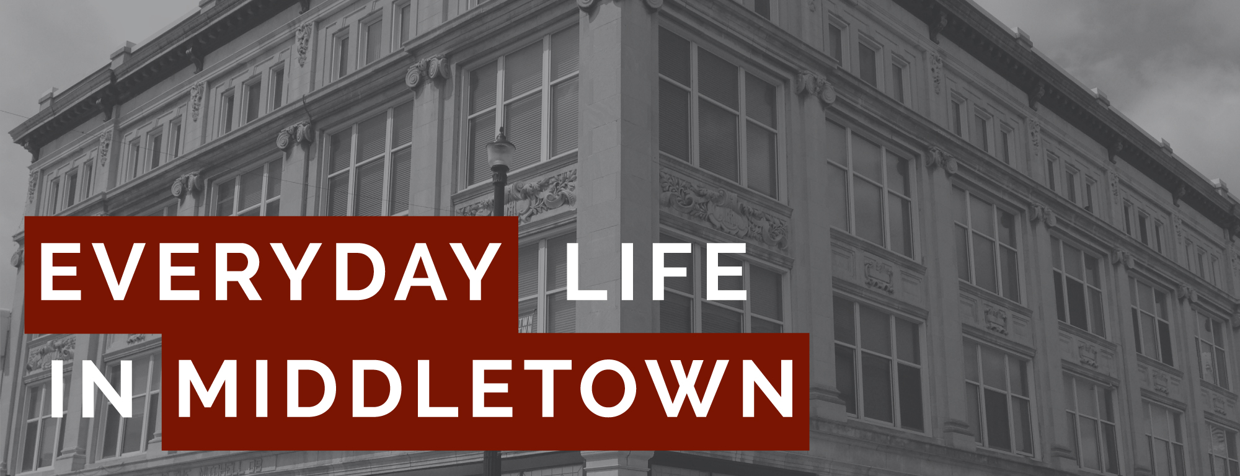
Pat Collier,
Jim Connolly
edlmiddletown@gmail.com

Slide 9
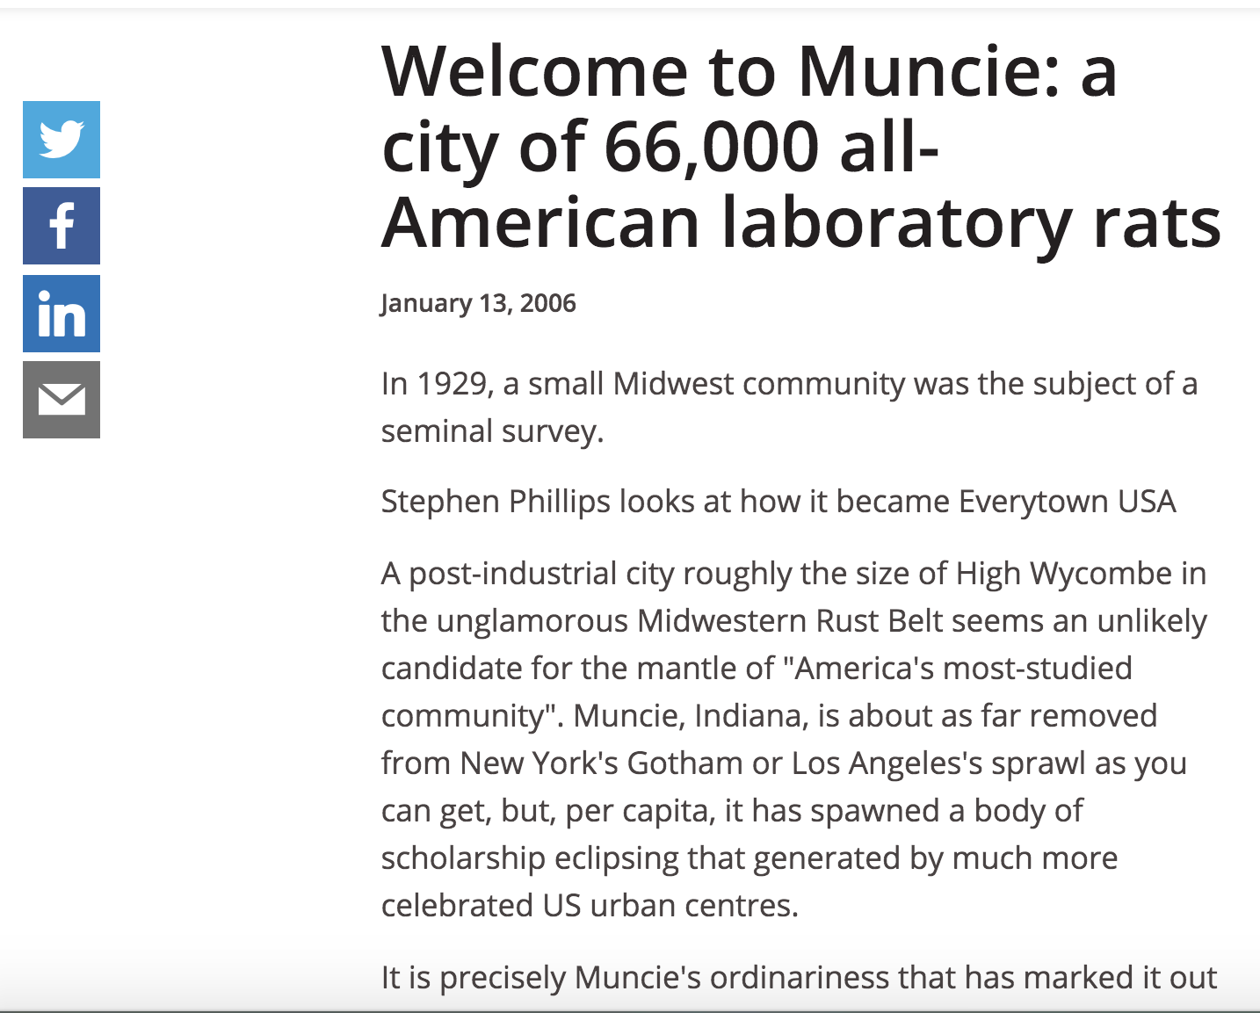
What Not To Do…..
Notes:
Legacy of distrust, tension
Necessity of collaboration (evolution of Center’s agenda)

Slide 10
Humanities
Start with a research question grounded in the literature of the field.
  Not: community engagement→scholarship (difficult to retrofit)
Know the community/establish ties
Funding: Aim for scholarly and community value
  Sense of place (arts and humanities)
Collaborative approaches
Notes:
Examples: local funding of oral histories; EDLM

Slide 11
Educational Innovations: Formal & Informal
Baseline data
Trend analyses, longitudinal studies, cohort design
Intervention studies – strategies to effectively evaluate impact
  Pre-post
  Randomized control trials
  Regression discontinuity
Business as Usual vs Control vs Comparison
Cost-Benefit Examinations
Stakeholder-Focused Evaluation Planning
  Logic maps, cooperative planning/engagement

Slide 12
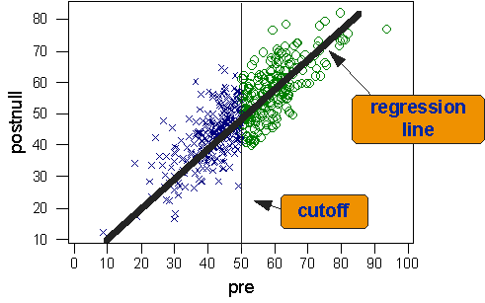
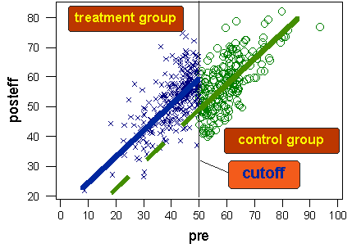
Regression Discontinuity – In Brief
Graphics credit: https://socialresearchmethods.net/kb/quasird.htm

Slide 13




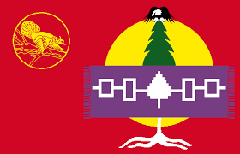


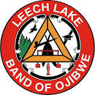
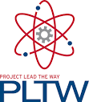



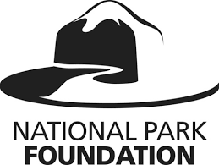





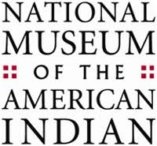



Research Design Expertise ---> Partners

Slide 14
Social Sciences
Histories of collaborations
Holism and cultural relativism
When community engagement is designed with multiple goals in mind, the challenges for implementation are outweighed by the multiplicity of benefits for individuals, programs, and institutions.
Notes:
Essential to start with a solid research design with all approvals
Start with the community’s needs
Why and when community engagement fails
Ethics of collecting data

Slide 15
Citizen Science and Water Quality Project, Hazard KY
Service
Provide much-needed data (raw and analyzed) to local partners
Establish partnerships
Teaching
Generate results about personal transformation and loyalty to Appalachia
Results about civic engagement, likelihood to pursue advocacy and/or activism
Scholarship
Results about citizen science participation in Appalachia
Results about water quality in Hazard
Notes:
Assessment, broadly construed and applied, connects the teaching, scholarship, and service arms of the service-learning project. Through carefully crafted assessment instruments methodologically placed throughout the service-learning experience, data related to service-learning, the research question at hand, and community-based endeavors can be obtained. In this case study, the direct measure of student learning is assessed through Fieldwork Reflections assignments. In analyzing these assignments, two themes emerged that illustrate how students acquired knowledge of core anthropological concepts through experiential learning. First, students came to fully understand the technical details related to ethnographic research by doing- the stress of completing human subjects training, reflecting on anxieties about culture shock, to interacting with people on the ground to understand their lived experiences. Second, students discussed the complications of limiting their understandings of inequalities in simplistic, causal fashions when they heard firsthand the many ways that people discuss their daily survival.
Case Study
Firstly, the principle research focus addresses perceptions of environmental health risks and citizen science potential in Appalachia. Water quality in eastern, Appalachian Kentucky has been severely compromised by a long history of extractive industries. While communities talk about their water as “bad,” there is little research that focuses on barriers to mobilizing action to address poor water quality. In an effort to invest ownership of water quality testing within the community, between 2006-2008, 1,660 water samples were collected from across eastern Kentucky to measure water quality. Throughout the project, dubbed the “Big Dip,” more than 60 students and volunteers from the region participated in water sampling.
Ten years later, in 2016, community volunteers again gathered to test a sub-sample from the original the original project. Anthropology students enrolled in a service-learning course partnered with the community to understand two broad areas: perceptions of risk and control related to environmental hazards and motivation for participating in civic action. With an overall goal of sustained community action and mobilization of resources to achieve better water quality, it is essential to understand participants’ ideologies of health risks connected to poor water quality and other environmental threats.

Slide 16
Holistic Inputs= Holistic Outputs
Research
Survey responses (data)
Conference presentations
Publications
Teaching
Reflection essays (data)
Conference presentations
Publications
Service
Community conversations and use of data
Conference presentations
Notes:
Research
With regards to the research question, the survey results showed that community members often identified environmental factors as contributing to disease rates. According to the responses, community members believed that environmental factors play a major role in causing asthma, sinus and allergy problems, and colds and flus. The severity of these illnesses is less than that of others listed, such as cancers and birth defects. In addition, the survey prompted respondents to consider whether they have enough information about what they can do to protect themselves and their family from environmental health problems. These results indicate that 50% of those who responded to the survey do not have enough information to protect themselves from environmental health risks.
Importantly, the results state that 10% of people surveyed feel that they can make a major impact on environmental factors which effect their health. Only half of the remaining respondents felt they could do even a moderate amount to positively influence these conditions. One person felt they had no power over their environmental health risks. Further, the results show that most community members are ‘likely’ or ‘extremely likely’ to participate in local politics.
Teaching
A parallel and equally important stream in the project is understanding participants’ self-identified potential to participate in civic action provides an opportunity for service-learning students to theorize the disconnect between knowledge and action. Of particular importance to this project is the idea that risk is differently perceived based on insider versus outsider status. This distinction diminishes among the proposed participants and service-learning students, who exist simultaneously as insiders due to their Appalachian-cultural identity as well as outsiders as a result of their participation in higher education.
Service
With regards to service, these data are essential for establishing data-driven, community-informed interventions to strengthen individual and community-level well-being within the global marketplace. Results indicate that community members are aware of the health risks in their environment, though additional information about what to do about those environmental threats are needed. Community members indicate a preparedness to participate in processes that will result in cleaner and safer environments, which may increase the overall level of environmental health risk awareness among other community members.

Slide 17
Reflections: Challenges and Opportunities
What is YOUR starting point?
What will hold you/your constituents back?
What do you need to achieve success?
How does what you take from your community partner get re-invested and returned to your community partner?
Are you collaborative in this engagement?

Slide 18
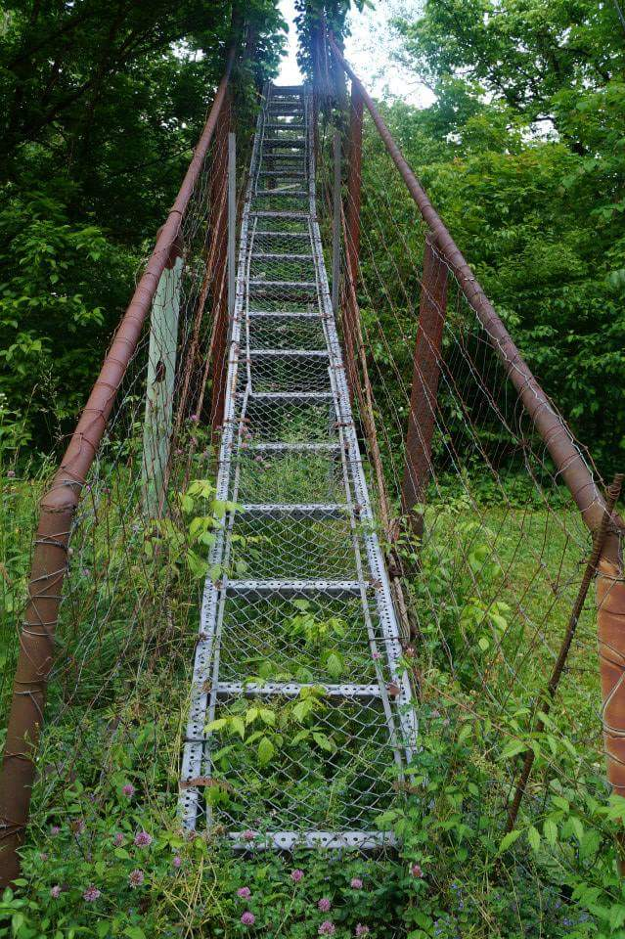
What are the next steps?
Identify three assets or sources of support for community engaged scholarship.

Slide 19
THANK YOU!

Slide 20
Titles of Books/Documentaries featured in “Muncie as Middletown , 1929-“ slide:
Robert and Helen Lynd, Middletown: A Study in Modern American Culture (1929)
Robert and Helen Lynd, Middletown in Transition: A Study in Cultural Conflicts (1937)
Middletown (Film Series), 1982-
Theodore Caplow et al., All Faithful People: Change and Continuity in Middletown’s Religion (1983)
Theodore Caplow et al., Middletown Families: Fifty Years of Change and Continuity (1985)
Rita Caccamo, Back to Middletown: Three Generations of Sociological Reflections (2000)
Ben J. Wattenberg, et al., The First Measured Century (2000)
Eric Lassiter et al., The Other Side of Middletown: Exploring Muncie’s African-American Community (2003)
Laurie Stern and Stephen Smith, Hard Times in Middletown: From the Middle Class to the Brittle Class (Radio documentary, 2009)
Frank Felsenstein and James J. Connolly, What Middletown Read: Print Culture in an American Small City (2015)
Himanee Gupta, Muncie, India(na): Middletown and Asian America (2018)

