Slide 1
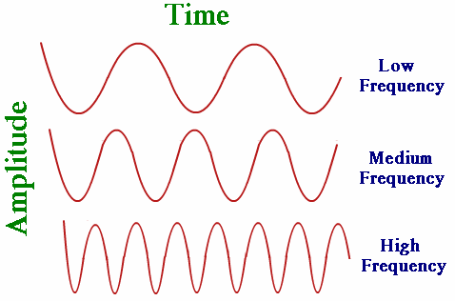
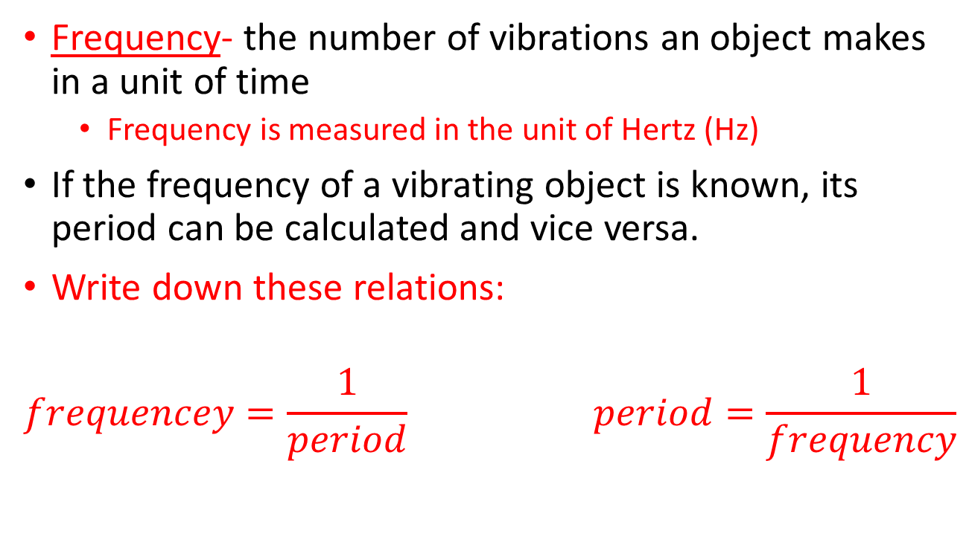
Frequency
Frequency- the number of vibrations an object makes in a unit of time
  Frequency is measured in the unit of Hertz (Hz)
If the frequency of a vibrating object is known, its period can be calculated and vice versa.
Write down these relations:
$$frequencey=\frac{1}{period} period=\frac{1}{frequency}$$

Slide 2
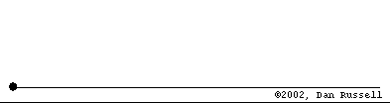
25.4: Wave Speed
Animation from Dr. Dan Russel

Slide 3
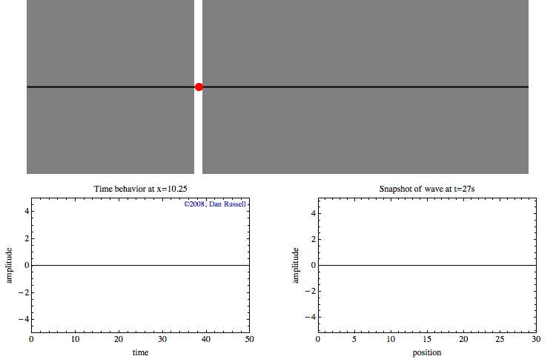

Finding the Wave Speed
You can calculate the wave speed (v) of a wave by multiplying the wavelength (λ) by the frequency (f).
$$v=fλ$$

Slide 4
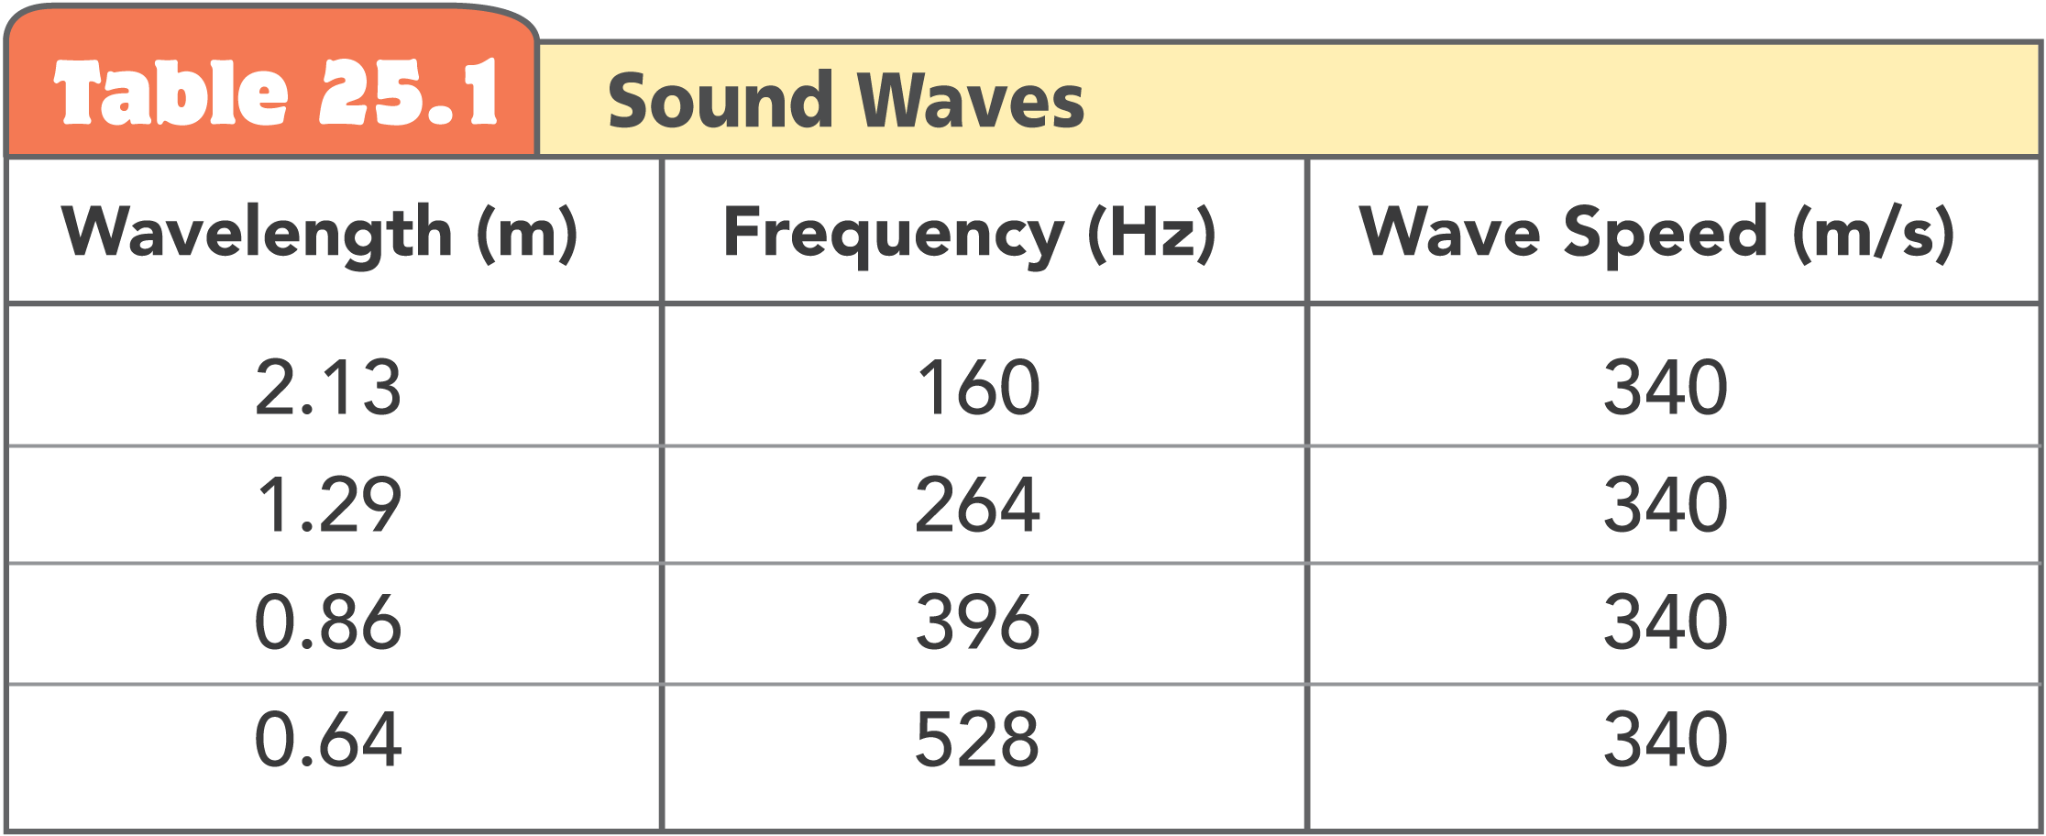
Here are some values of wavelengths and frequency of sound waves in air around room temperature. What do you notice?

Slide 5
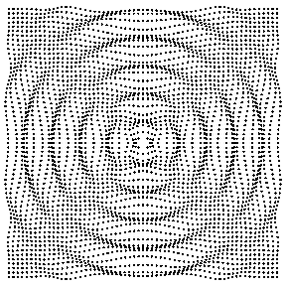
25.7: Interference
Animation from Dr. Dan Russel

Slide 6
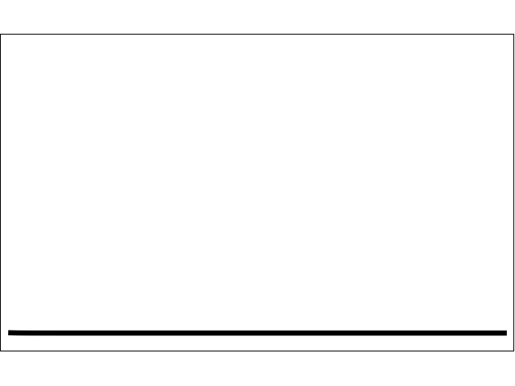
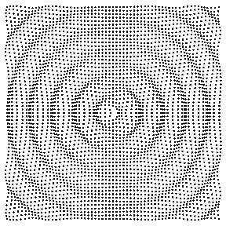
Interference Pattern
An Interference Pattern is a regular arrangement of places where wave effects are increased, decreased, or neutralized.
Interference patterns occur when waves from different sources arrive at the same point-at the same time.

Slide 7
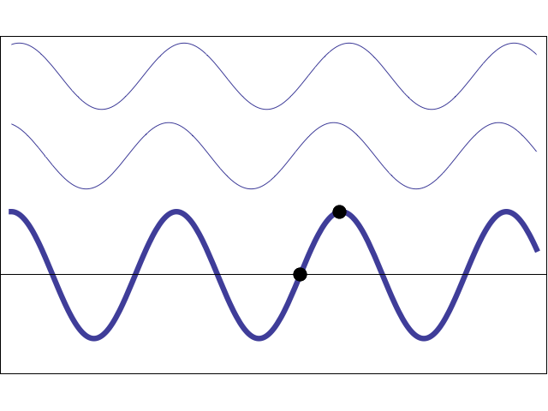
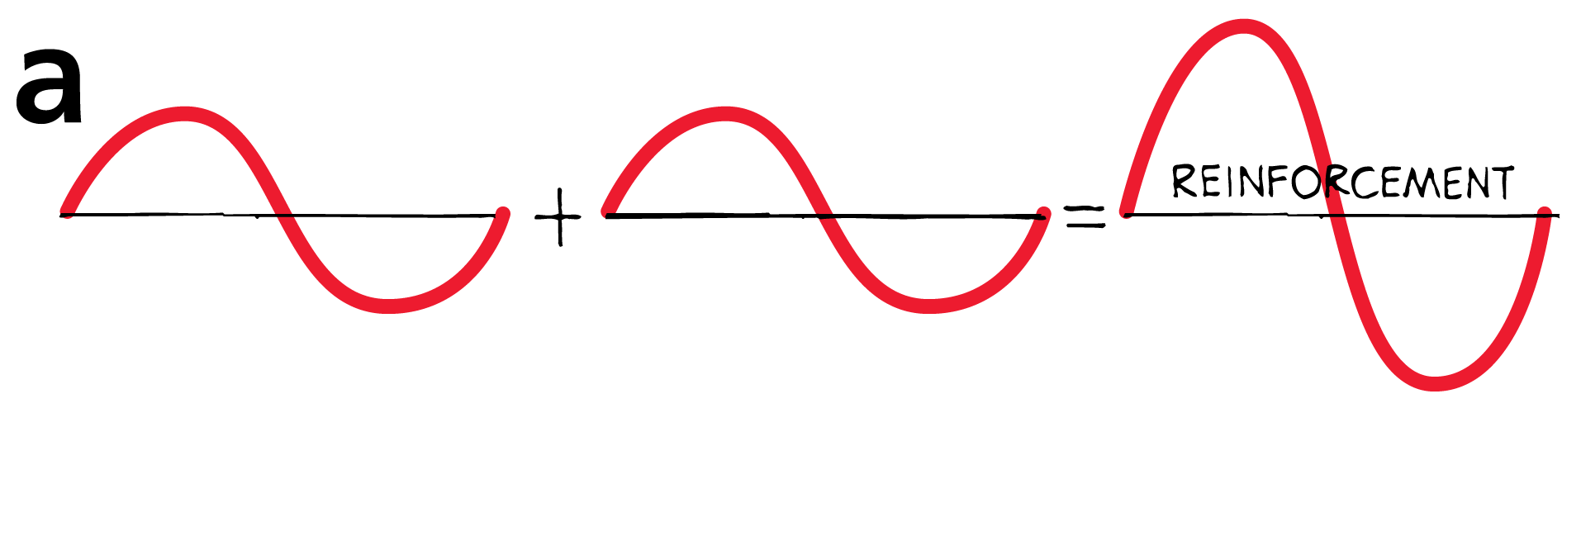
Constructive Interference
Constructive Interference- Addition of two or more waves when wave crests overlap to produce a resulting wave of increased amplitude.
When waves are in-phase, the crests of one wave overlap the crest of another.

Slide 8
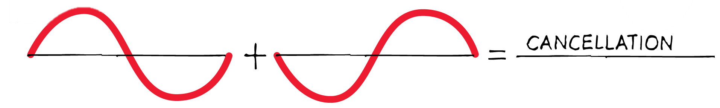
Destructive Interference
Destructive Interference- Combination of waves where crests of one wave overlaps troughs of another, resulting in a wave of decreased amplitude.
When waves are out of phase, the crests of one wave overlap the troughs of another.

