Slide 1

25.9: The Doppler Effect
Animation from Dr. Dan Russel

Slide 2
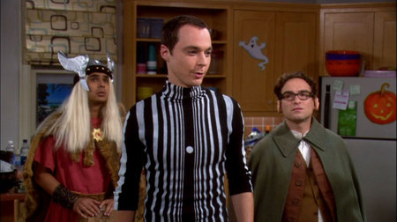
What is the Doppler Effect?
https://www.youtube.com/watch?v=z0EaoilzgGE

Slide 3
The Doppler Effect
Imagine a jiggling bug in a pond. When the bug is stationary, it produces waves in a circle, when it begins to move, the wave pattern is no longer concentric.

Slide 4
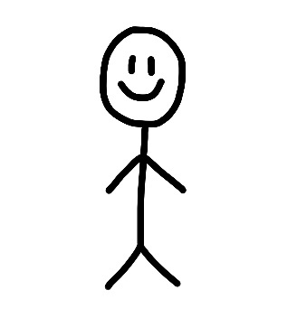
The Doppler Effect
As a wave source approaches, an observer encounters waves with a higher frequency. As the wave source moves away, an observer encounters a wave with lower frequency.
Lower Frequency
Higher Frequency

Slide 5
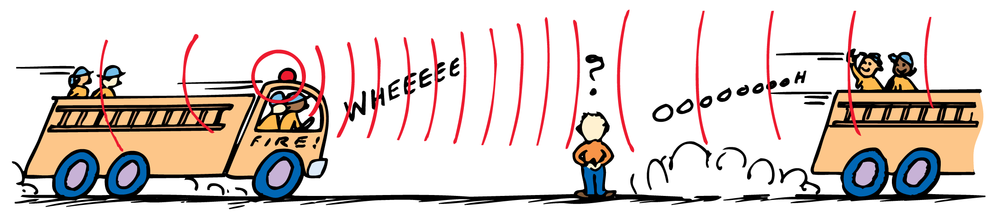
Doppler Effect with Sound
With sound, we hear a higher frequency when an object approaches us and a lower frequency when an object moves away from us.
Can you think of anywhere you’ve heard this kind of effect?

Slide 6
Doppler Effect with Sound Examples
https://www.youtube.com/watch?v=imoxDcn2Sgo
https://www.youtube.com/watch?v=a3RfULw7aAY
https://www.youtube.com/watch?v=NnsrDwNGsgg
https://www.youtube.com/watch?v=O5rqMPdQMQ8
https://www.youtube.com/watch?v=qyxvPiOqEiE
https://www.youtube.com/watch?v=N7_NbgqqKss

Slide 7
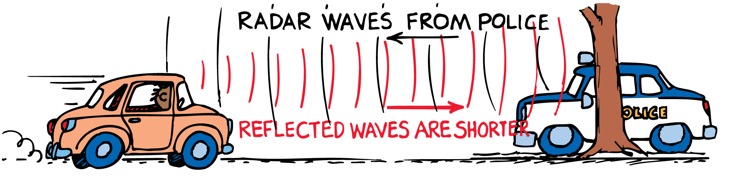
Doppler Effect with Light
The Doppler effect also occurs with light.
When an object comes towards a us, the light is blue shifted- a shift towards the blue end of the spectrum because of an increase in frequency.
When an object goes away from us, the light is red shifted- a shift towards the red end of the spectrum because of a decrease in frequency.

Slide 8
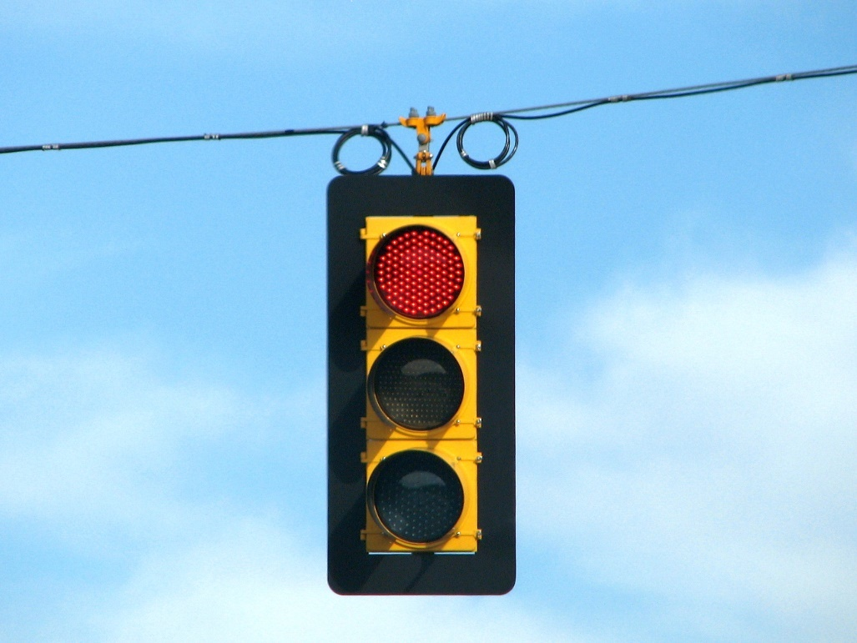
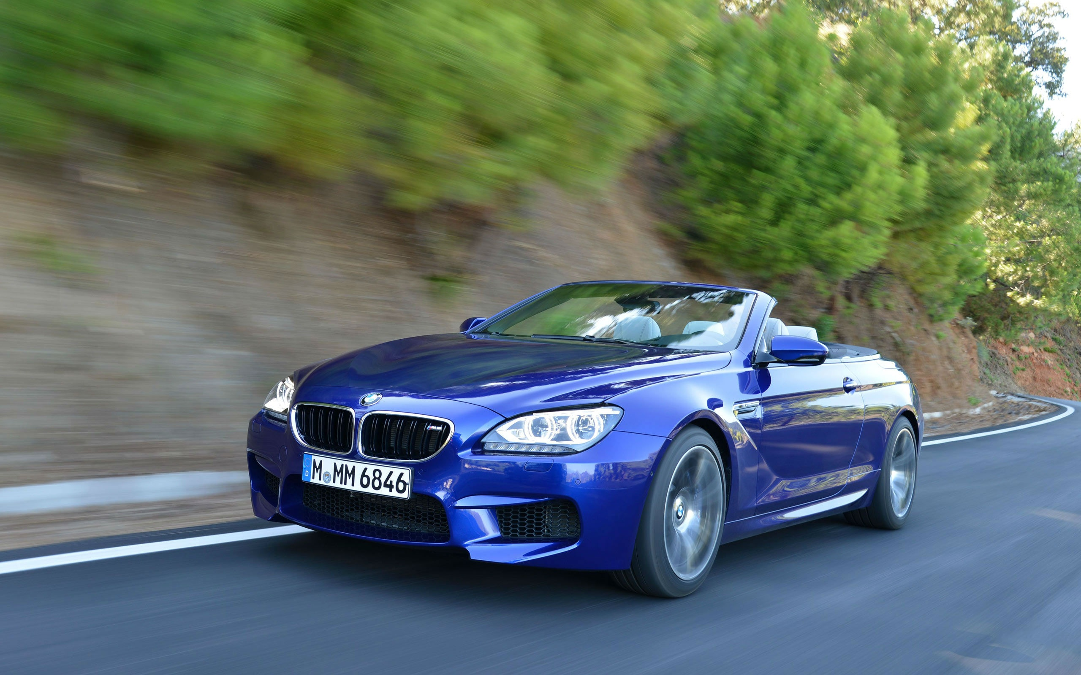
Thought Question
Can a red light look green because of the Doppler effect?
Could a blue car look red because of the Doppler effect?

Slide 9

Doppler Effect with Light Equation (Non relativistic)
A car must travel around 150,000,000 mph or about 1/5 the speed of light for a red traffic light to look green.
A blue car must travel around 313,000,000 mph or about 1/2 the speed of light away from an observer for it to look red.

