Slide 1
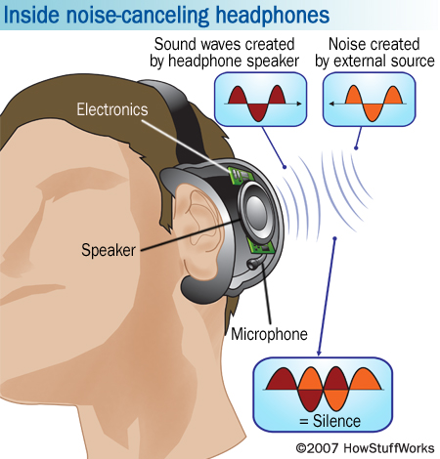
26.9: Interference

Slide 2
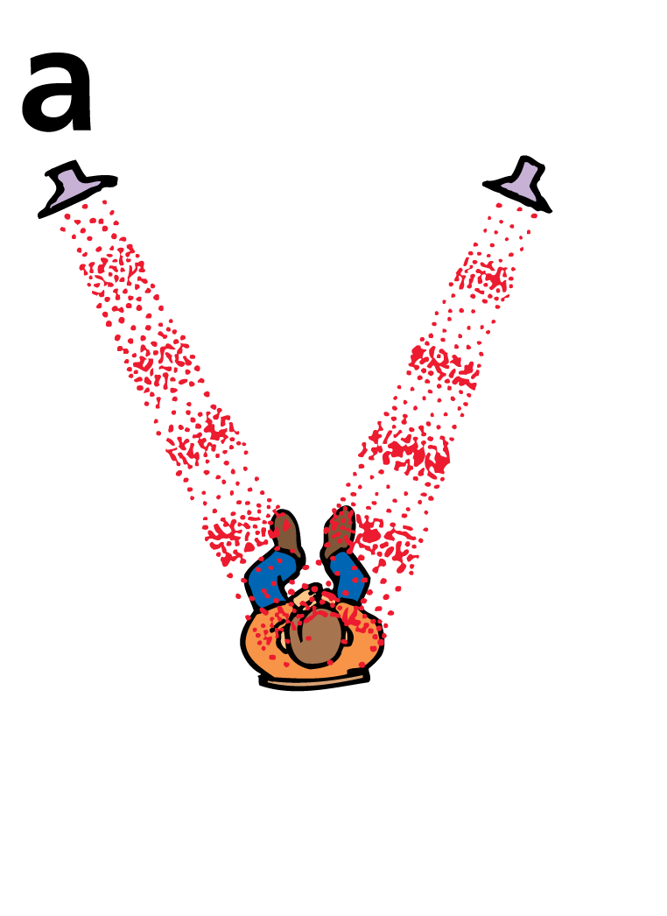
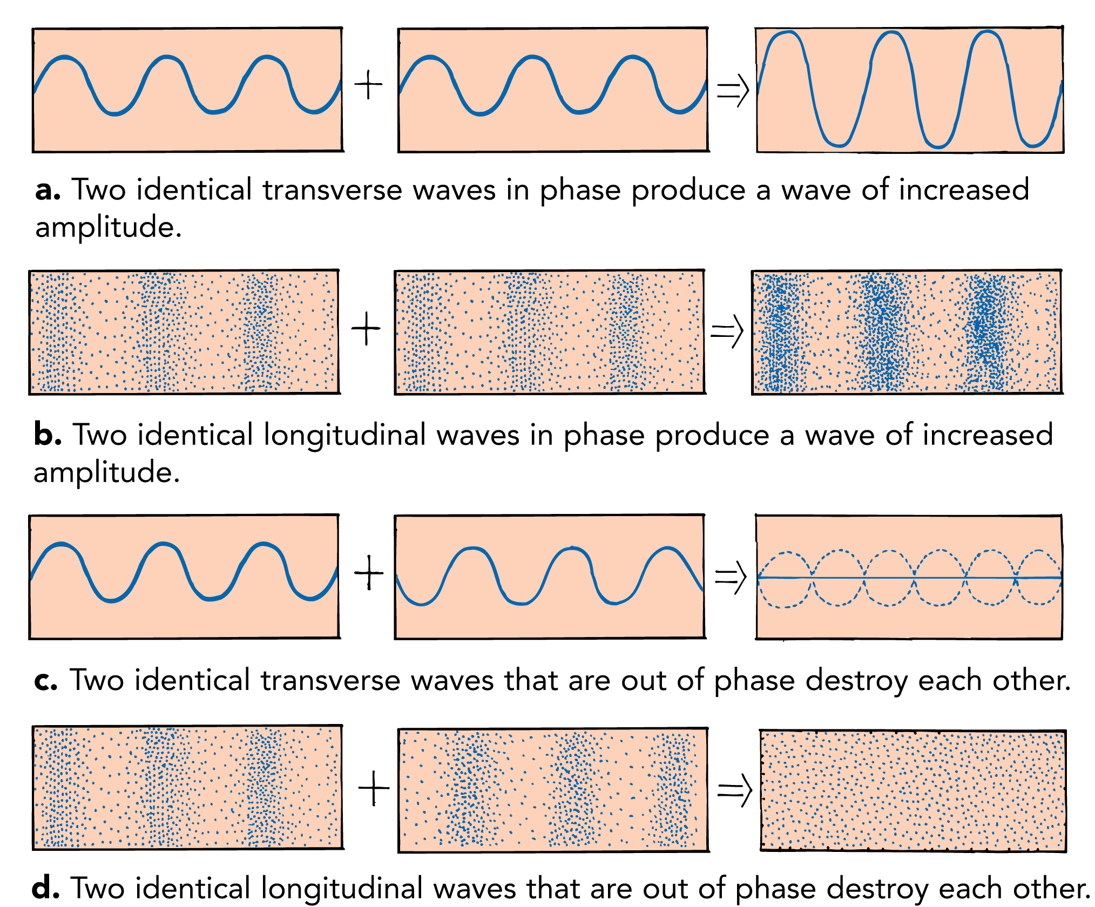
Constructive Interference
When constructive interference occurs with sound waves, the listener hears a louder sound.

Slide 3
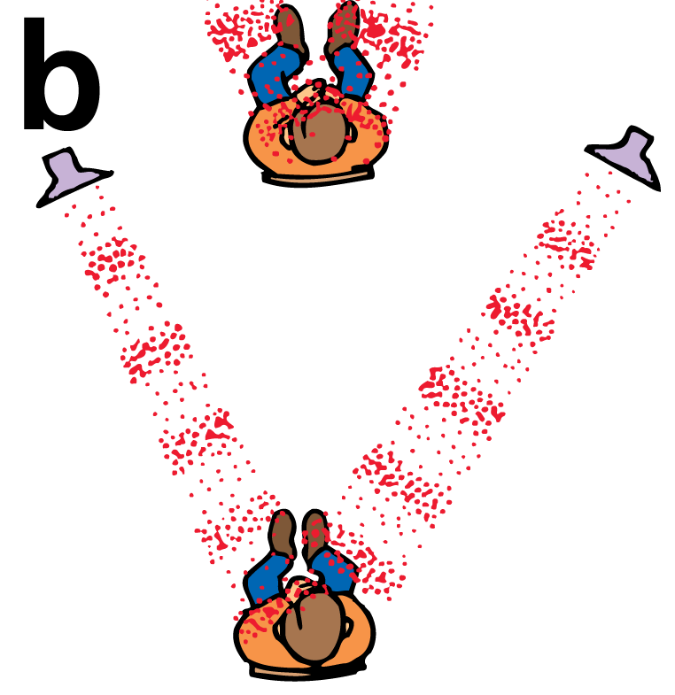
Destructive Interference
When destructive interference occurs, the listener hears a fainter sound or no sound at all.

Slide 4
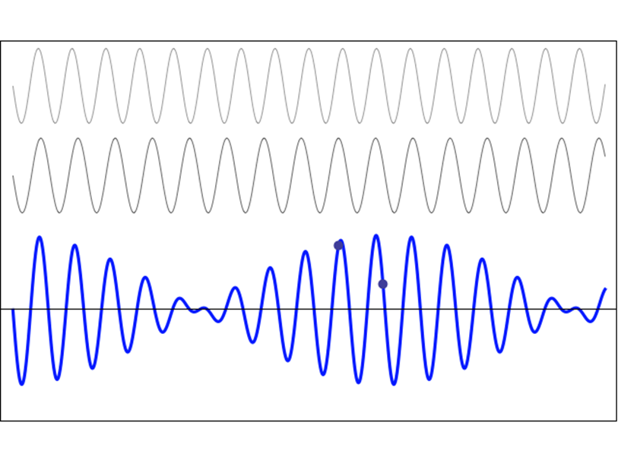
26.10: Beats

Slide 5
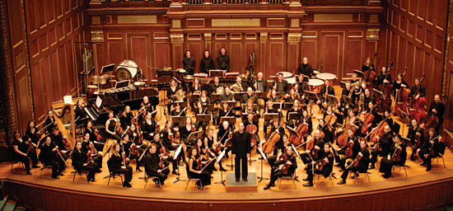
Tuning Instruments
Thought Question: How do musicians tune their instruments?

Slide 6
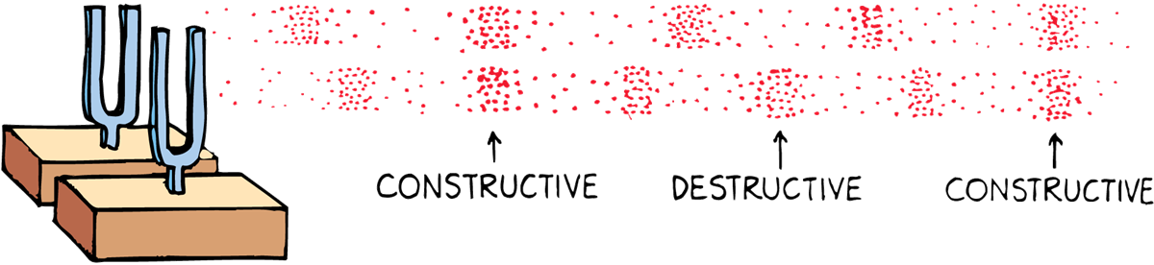
Beats
When two tones of slightly different frequency are sounded together, a regular fluctuation in the loudness of the combined sounds is heard.
Beats- The periodic variation in the loudness of sound caused by two tones of slightly different frequency

Slide 7
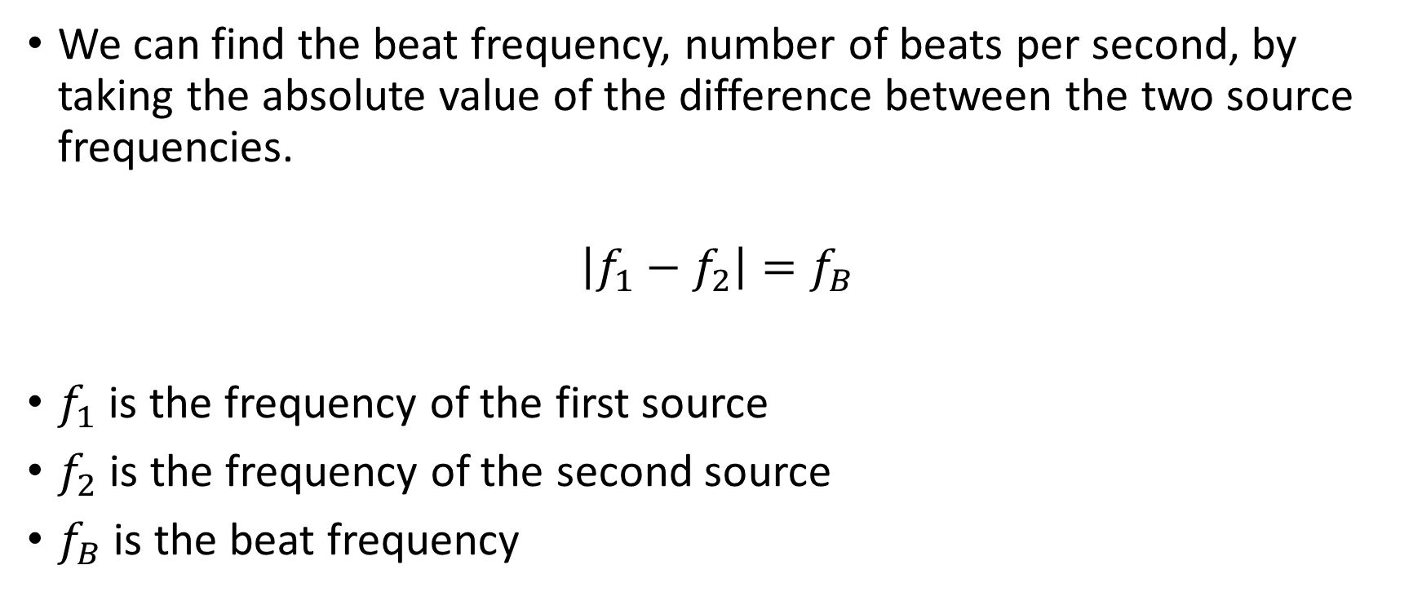
Finding the Beat Frequency
We can find the beat frequency, number of beats per second, by taking the absolute value of the difference between the two source frequencies.
$$\left|f_{1}−f_{2}\right|=f_{B}$$
$f_{1}$ is the frequency of the first source
$f_{2}$ is the frequency of the second source
$f_{B}$ is the beat frequency

