Slide 1
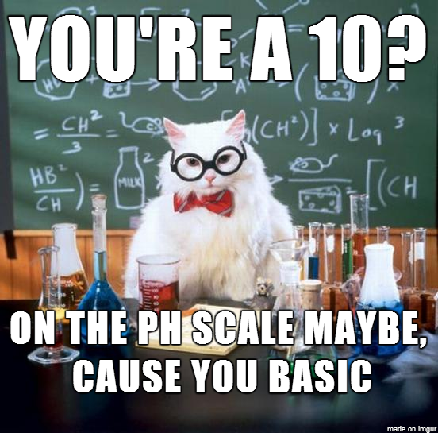
Acids and Bases
The next time someone calls you “basic” you will have a comeback for them!

Slide 2
After this lesson, you’ll be able to say…
I can describe the process of dissociation as it results in ion formation.
I can define acids and bases based on how they behave in water.
I can list the known acids and bases.
I can describe the differences between strong acids/bases and weak acids/bases.
I can confirm the acidity of a substance based on using its pH value.
I can label the acid, base, and conjugates in a reaction.
I can deflect insults with intelligence and wit!

Slide 3
Remember last week?
Element -
Compound –
Solution –

Slide 4
Acids v.s. Bases – Who’s who?
Acid –
Base –
Acids | Bases

Slide 5
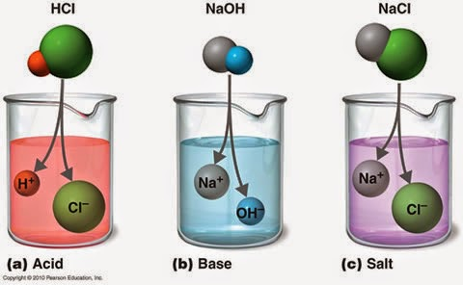
Dissociation – “to separate”
Dissociation occurs when

Slide 6
Strong v.s. Weak – A test of strengths!
Strong Acid –
Strong Base –
Weak Acid or Base -

Slide 7
Which ones do you need to know?
Acid Name | Formula | Strong/Weak? | Base Name | Formula | Strong/Weak?
Hydrochloric acid |  |  | Sodium hydroxide
Nitric acid |  |  | Potassium hydroxide
Sulfuric acid |  |  | Barium hydroxide
Acetic acid |  |  | Ammonia
Carbonic acid |  |  | Methyl amine
Phosphoric acid

Slide 8
Conjugates
Conjugate Acid –
Conjugate Base –
Label the acids, bases, and their conjugates:
NH₃ + H₂O → NH₄⁺ + OH⁻ HCl + NH₃ → NH₄⁺ + Cl⁻

Slide 9
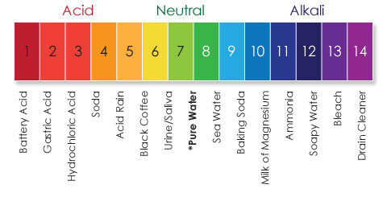
The pH Scale
A substance can be either acidic, neutral, or basic (alkaline):
Acidic:
Neutral:
Basic (Alkaline):
The pH level and scale are used to measure this. The pH scale ranges from 1 to 14.
1 being the most acidic level and,
14 being the most basic level.

