Slide 1
Cellular Respiration
By J. R. Fromholz-Smith

Slide 2


Slide 3
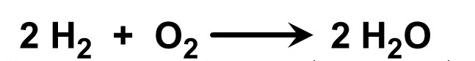
Review of Reactants & Products
A reactant is a substance that undergoes change in a reaction (found on the right side of the chemical equation).
A product is a substance that is formed as a result of a chemical reaction (found on the left side of the chemical equation).

Slide 4
Goals for Today
Know the generalized chemical equation for cellular respiration.
Define each of the four stages of cellular respiration.
Identify the general stages of cellular respiration based on a given chemical equation.

Slide 5
(insert drawing of cellular respiration overview)

Slide 6
Stages of Cellular Respiration
Glycolysis
Pyruvate Oxidation
Krebs Cycle
Oxidative Phosphorylation

Slide 7
Glycolsis

