Slide 1
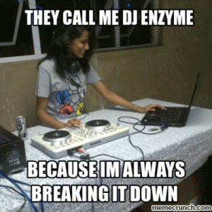
Enzymes
Proteins on a mission
Notes:
But not really, they can also build things up

Slide 2
Today’s Objectives
Describe a general enzyme-catalyzed reaction
Discuss the relation of temperature and pH to rate of reaction in an enzyme-catalyzed reaction
Explain how chemical reactions are affected by enzymes
Identify the qualifying characteristics of a metalloenzyme
Notes:
Get spit before moving on

Slide 3
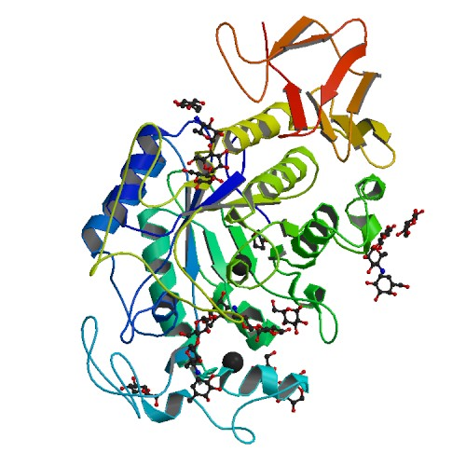
What was that all about??
Saliva contains an enzyme called Amylase which breaks the polymer starch down into its monomers, sugars .
The crushed up cracker contains a lot of starch. What do you think will happen to the starch as it interacts with the saliva and with the water?
Notes:
Just write down predictions, we’ll talk more about this later

Slide 4
The simple facts
All enzymes are proteins, but not all proteins are enzymes
REMEMBER! Proteins (including enzymes) are held in their 3D forms by hydrogen bonds… this will be important later!
Enzymes usually end with the suffix –ase
Enzymes catalyze or speed up chemical reactions.
They do this by building up or breaking down molecules
Anabolic enzymes build up molecules
Catabolic enzymes break down molecules
Almost all metabolic processes in cells need enzymes in order for reactions to occur fast enough to sustain life
Notes:
What does amylase break down again? Starch synthase is opposite. Which is catabolic and anabolic?

Slide 5
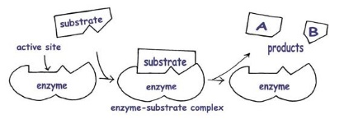
How do they work?
This enzyme is a catabolic enzyme
Notes:
Important to note that what goes in is called the SUBSTRATE and what comes out are PRODUCTS

Slide 6
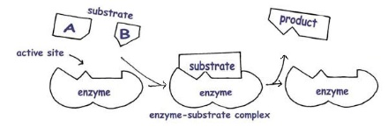
They can also work this way!
This enzyme is an anabolic enzyme

Slide 7
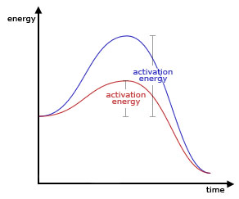
Why are enzymes so necessary?
Activation energy is the amount of energy needed for a reaction to occur
Enzymes increase the rate of reaction by lowering the activation energy
Which of the lines on this graph shows an enzyme-catalyzed reaction?
What is another way that activation energy might be reduced in a reaction (without using an enzyme)?
Notes:
Necessary b/c in biological systems, you can’t always turn up the heat
How do you think an increase in temperature would affect an enzyme-catalyzed reaction?

Slide 8
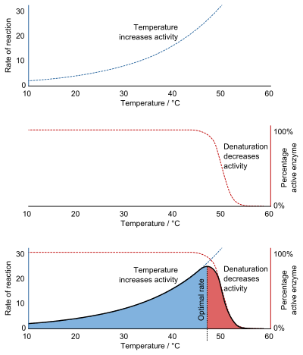
Enzymes and temperature change
In general, an increase in temperature increases the rate of a chemical reaction…
But an enzyme can only get so hot before its hydrogen bonds break, or denature

Slide 9
Enzymes and temperature change
When we overlay the two previous graphs, we can see that enzymes have an optimal temperature range
What do you think is the optimal temperature for the enzymes in our body? At what temperature do you think enzyme activity would begin to decrease?

Slide 10
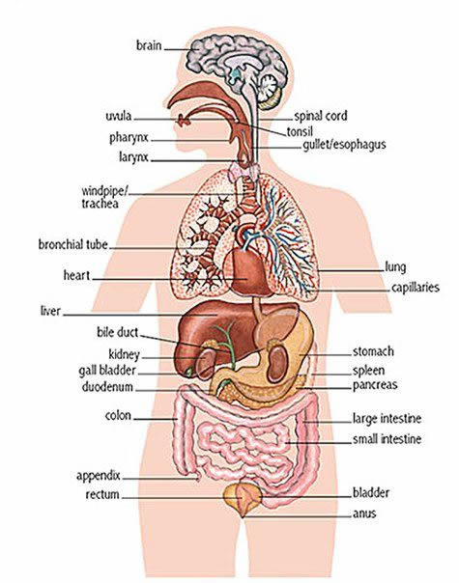
Enzymes and pH change
Different areas of the body have different normal pHs
A healthy stomach pH is 1.5 - 3.5
A healthy mouth pH is 5.6 - 7.9
The enzymes that exist in various areas of the body typically have optimum pHs that match the pH of that area.
Pepsin (digests protein in the stomach) has an optimum pH of 2
Amylase has an optimum pH of 7
Notes:
Ideal for amylase, 7. pH of mouth, 5.6-7.9
Ideal for pepsin (a protase which digests proteins) is 2, pH of stomach, 1.5-2

Slide 11
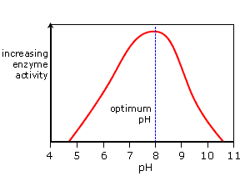
Enzymes and pH change
Like temperature, pH also affects hydrogen bonding, and therefore, enzyme activity.
Some enzymes have wider ranges, but often they behave like Goldilocks, only working well in a small pH range.
What do you think the effects of a pH imbalance might be in the mouth? Would drinking acidic coffee (pH 5) help or hinder amylase’s ability to digest starches?
Notes:
Ideal for amylase, 7. pH of mouth, 5.6-7.9
Ideal for pepsin (a protase which digests proteins) is 2, pH of stomach, 1.5-2

Slide 12
Did you know?
Many enzymes are composed of more than just amino acids!
Metalloenzymes make up around 1/3 of all enzymes, and this special type incorporates metal atoms into the structure
NOTE! Metal is not part of the polypeptide/amino acid chain, but gets “tangled” up in the folded protein and held in place by covalent bonds
Notes:
Ca+ in amylase
Does this look familiar to you at all?

Slide 13
Back to our spit!
Iodine + starch = purple/black
Iodine + sugar = red/brown
Looking back at your prediction from earlier, what color do you think the solutions will turn when iodine is added?
saliva
water
Notes:
Write color predictions in cups, indicate if they were right afterwards
What is substrate here? What is product?

Slide 14
Wrapping up
Enzymes are specific types of proteins
Some enzymes incorporate a metal atom and are called metalloenzymes
Enzymes that build molecules up are called anabolic enzymes
Enzymes that break molecules down are called catabolic enzymes
Enzymes take substrates and convert them into products
In-between, they form an enzyme-substrate complex
Enzymes increase the rate of a reaction by decreasing the activation energy
Due to the importance of hydrogen bonding in enzymes, they have optimal temperature and pH ranges

