Slide 1
Monatomic Ions
Why they form & how We name them

Slide 2
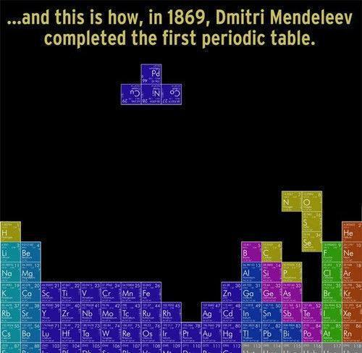
Why is the Periodic Table arranged like that?
Notes:
Have you ever wondered why the periodic table is shaped in the funny way that it is?
Obviously this is just a joke, there is in fact a lot of order in this table.
It organizes elements based on their properties, one of which is the charge that they take in their ionic forms. Let’s see how that works.

Slide 3
What you’ll be able to do:
Determine the charge of common monatomic ions based on their positions on the Periodic Table.
Differentiate between an anion and a cation.
Generate the name of monatomic anions and cations given the name of the neutral atom.
Determine whether or not there is a charge on an atom/ion given the number of protons and electrons.
Sketch a picture or diagram showing what happens to the electrons in a species during monatomic ion formation.

Slide 4
Just a reminder…
What is a valence shell?
The outermost occupied shell of an atom
What is the charge on a proton?
+1
On an electron?
-1
On a neutron?
0
Notes:
Write “The outermost occupied shell of an atom”

Slide 5
Let’s begin…
How many electrons fit in each shell?
Shell | Number of electrons
1 | 2
2 | 8
3 | 8
4 | 18
5 | 18
Notes:
Keep in mind that these numbers work for this one model that helps us understand the ionic properties of atoms, other models may have different numbers to help us understand different things.

Slide 6
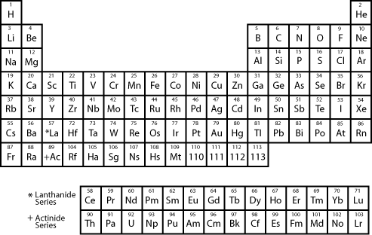
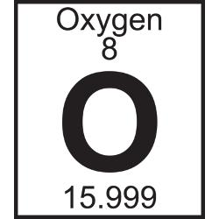
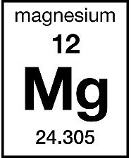
Understanding the Periodic Table
Notes:
This is a very simplified periodic table, but it gives us all that we need for right now.
What can we learn about the various elements from this table? → # protons, which is # electrons, which lets us find ionic charge
Let’s try a few examples. I’ll do Oxygen up here on the board and you can follow along, then try Magnesium on your own

Slide 7
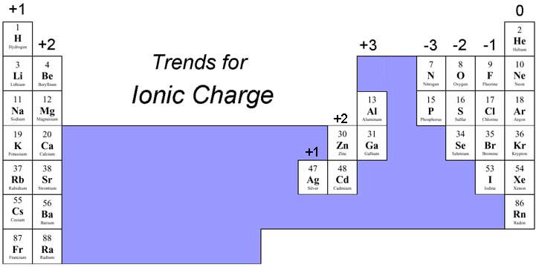
Understanding the Periodic Table (Quick reference)
Notes:
We don’t always need to go through to find the charge, this table shows the elements whose ionic charge is always the same.
Notice that not all the elements have this though, what’s going on there?

Slide 8
What about the rest of the table?
Transition metals can be tricky…
Many can exist in more than one chemical form or “oxidation state”
We’ll look more at these later

Slide 9
Naming the ions…
If an ion is POSITIVELY charged, what do we call it?
Cation
If an ion is NEGATIVELY charged, what do we call it?
Anion

Slide 10
Naming rules for CATIONS…
Let’s again look at Magnesium...
We decided its ionic form has a +2 charge
To write its abbreviation… Mg²⁺
(*If +1 charge, don’t write the number, just a +)
To write its full name… Magnesium ion
Now let’s try Lithium…
Abbreviation… Li⁺
Full name… Lithium ion
Notes:
Make point of not writing the 1
PRACTICE – Have them find Lithium on the periodic table, then write abbreviation and full name

Slide 11
Naming rules for ANIONS…
Let’s again look at Oxygen...
We decided its ionic form has a -2 charge
To write its abbreviation… O²⁻
(*If -1 charge, don’t write the number, just a -)
To write its full name… “Oxide”
Add suffix “-ide” to element name
Now let’s try Chlorine…
Abbreviation… Cl⁻
Full name… Chloride
Notes:
Make point of not writing the 1 and also don’t put “ion”
Suffix –ide
PRACTICE – find Chlorine on periodic table, give abbreviation and full name.

Slide 12
Those tricky transition metals…
We have to denote the oxidation state
For example, Iron exits in both +2 and +3
Iron(II) or Iron(III)
Fe⁺² or Fe⁺³
Chromium (Cr) commonly has oxidation states of +2, +3, and +6…
Abbreviations… Cr⁺² Cr⁺³ Cr⁺⁶
Full names… Chromium(II), (III), (VI)
Notes:
NOTE – Don’t put a space b/w element name and parentheses
PRACTICE – Find Chromium and give abbreviations and full names

Slide 13
Questions, worksheet, discussion…

