Slide 1

Proteins
Notes:
What does this have to do with protein??
Balls of yarn are like protein

Slide 2
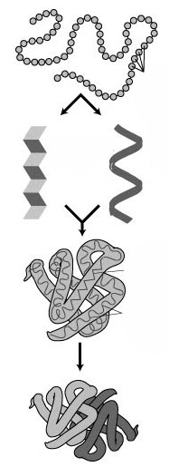
Protein… kind of like a ball of yarn
Notes:
Primary, secondary, tertiary, quaternary
Also fill in amino acids, Alpha helix, Beta sheet, indicate that 4th is 2 or more proteins

Slide 3
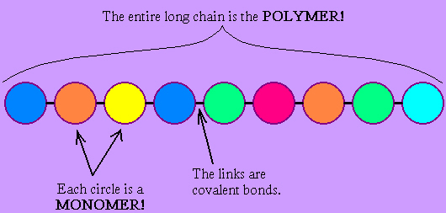
A closer look… General terms
Notes:
Fill in with just polymer, monomer, covalent

Slide 4
Now the more protein-specific terms
Notes:
Animo acid, peptide bond, polypeptide

Slide 5
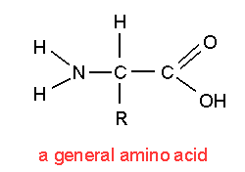
A closer look at an amino acid
Notes:
Circle and label using different colors?
Explain that the left and right sides of a single amino acid will always be that way, but the R group means that it changes.
Explain that you might also see them written as is shown on the next slides. Tell them to draw whichever they prefer when drawing amino acids.

Slide 6
Polymer formation
Notes:
Re-cover that it’s called a peptide bond… that’s just a special name for when two amino acids bond.
Circle the place where the bond will form… will the double bond break first or the single bond?
Talk about water leaving… when too much water leaves your body you become dehydrated, this is called a dehydration rxn
Draw the product on the bottom.

Slide 7
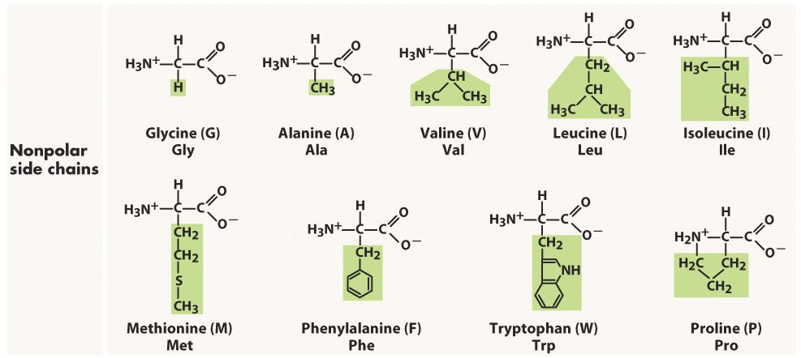
These R groups are…
Notes:
Non-polar

Slide 8
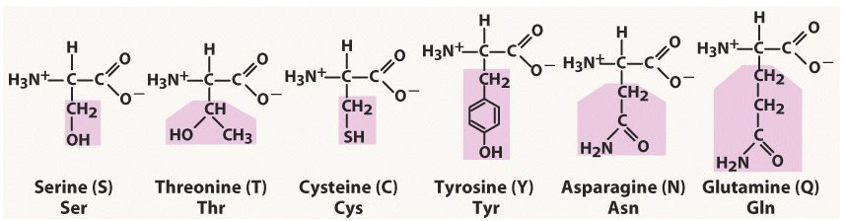
These R groups are…
Notes:
polar

Slide 9
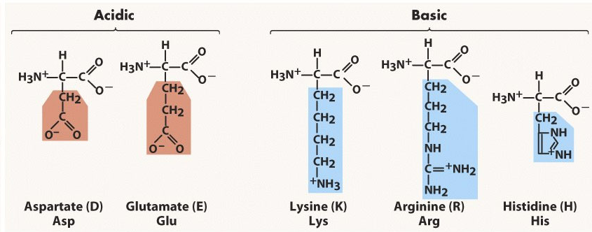
These R groups are…
Notes:
Charged, acidic and basic
Technically, the acids are displayed in their conj. Base forms, but they act as acids. Same for bases, they’re in conj. Acid forms.

Slide 10
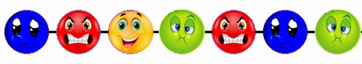
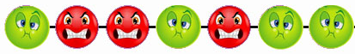
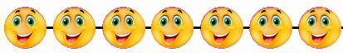
Why the funny shapes?
Notes:
Compare to a room full of people. Different types of interactions b/w different types of ppl, dynamics of room will change depending.

Slide 11
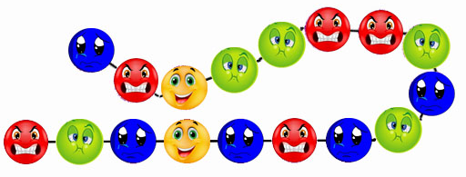
Why do they fold?
Notes:
Only one amino acid, cysteine, can form this type of bond.
Disulphide bond

Slide 12
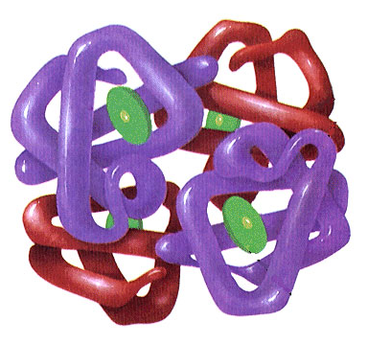
Why do they stick together?
Notes:
Hydrogen bonds, di-sulphide, vanderVaals, etc.

Slide 13
Recap on bonds…
Notes:
Primary -> Peptide (covalent)
Secondary -> Hydrogen bonds
Tertiary -> Disulphide (covalent), Hydrogen, Van der Waals, ionic
Quaternary -> Mainly Hydrogen bonds and Van der Waals

Slide 14
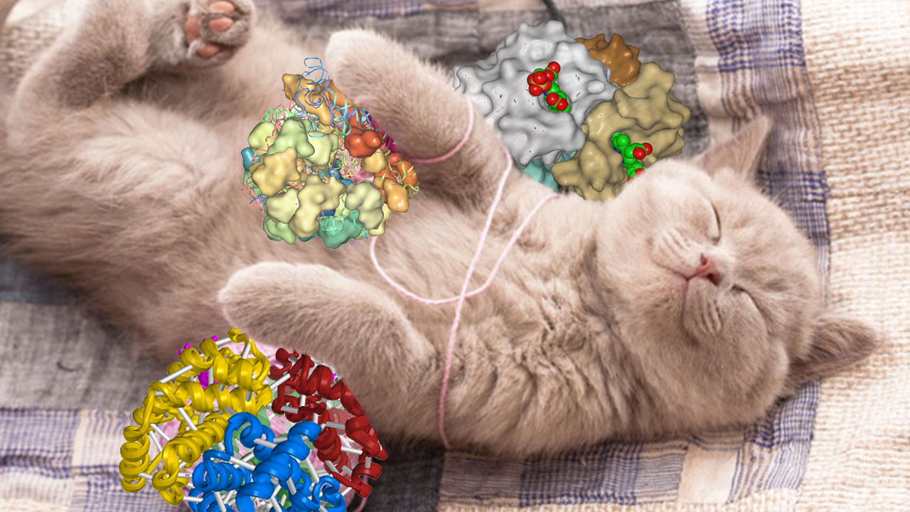
Questions?

