Slide 1
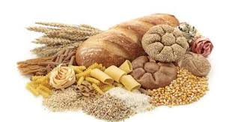
Carbohydrates
Alex Lantz

Slide 2
Carb Loading?
FACT OR FICTION
Before Video
After Video
Before Video
After Video
Why?
How?
With What?

Slide 3
Lesson Objectives
Students will be able to explain the difference between monosaccharides, disaccharides, and polysaccharides.
Students will be able to illustrate the formation of a disaccharide molecule from two monosaccharides.
Students will be able to explain how the human body processes carbohydrates for energy and what happens to the products that are not used.

Slide 4
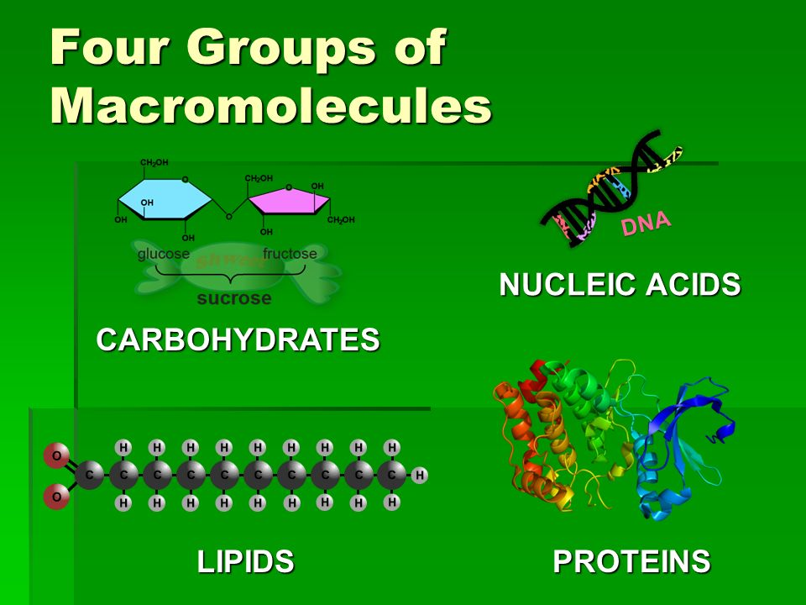
Important Biological Macromolecules!
Carbohydrates
Lipids
Nucleic Acids
Proteins

Slide 5
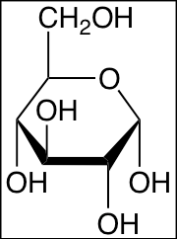
What are Carbohydrates?
Molecular Compounds made from 3 elements
1.)
2.)
3.)
Have a general molecular formula:
( )_{n}
Carbohydrates are also known as
, or sugars.

Slide 6
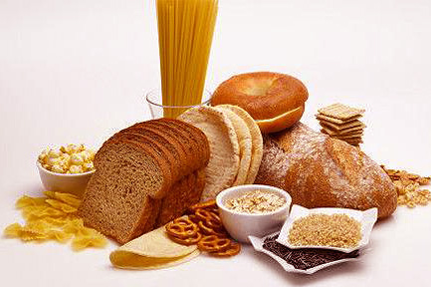
Role of Carbohydrates
Why are they important to us?
Major source of
Contain which assists in digestion and cholesterol management
Primarily found in food sources such as
Bread products (grains)
Fruits and Vegetables

Slide 7
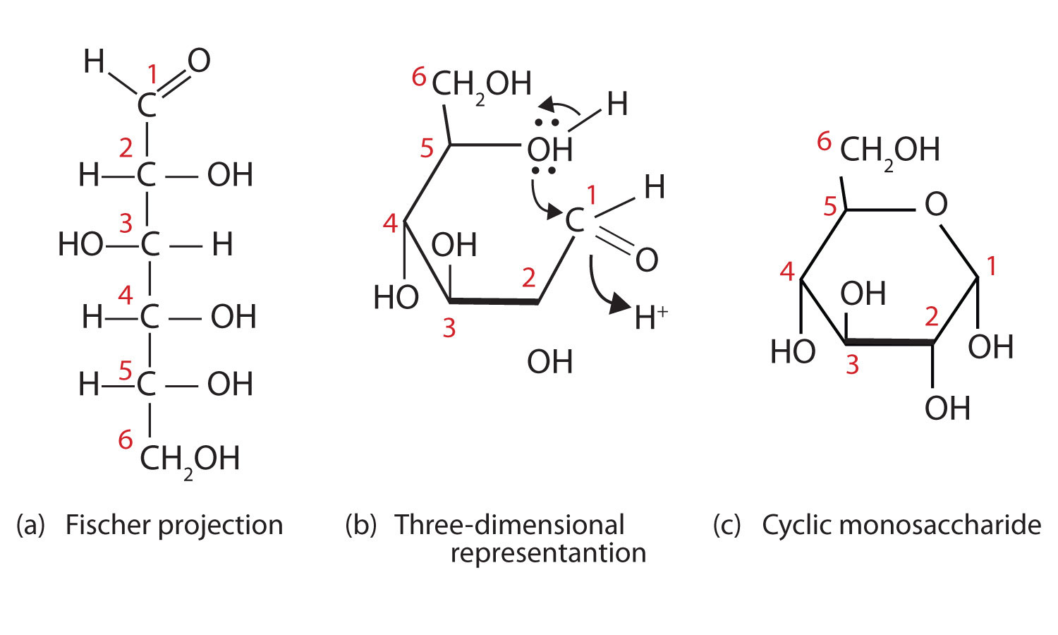
Representation of a sugar molecule
Cyclic Model
Most Commonly used for diagrams
Linear Model
Able to see all bonds

Slide 8
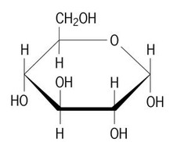
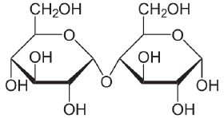
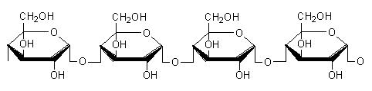
General Types of Carbohydrates
MONOsaccharides
-composed of sugar molecule
DIsaccharides
-composed of sugar molecules
POLYsaccharides
-composed of many sugar molecules

Slide 9
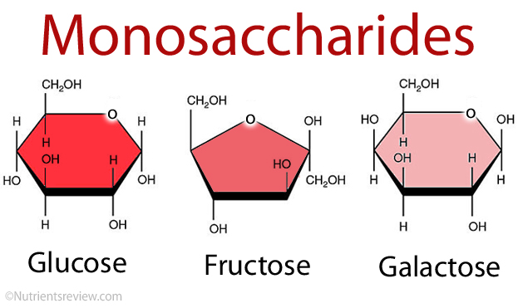
Monosaccharides
Single sugars
Classified by the number of Carbon atoms in each molecule
3 Carbons =
5 carbons =
6 carbons =
Examples of monosaccharides:
1.)
2.)

Slide 10
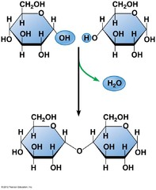
Disaccharides
Formed from two monosaccharides
Formed by a reaction
Held together by a bond
Ring shaped sugar molecule bonded to another molecule
Examples:
1.)
2.)

Slide 11
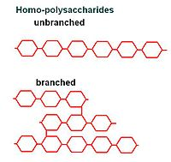
Polysaccharides
Formed from many sugar molecules bonded by dehydration reactions.
Held together by glycosidic bonds
Can be in two different forms:
or
Examples:

Slide 12
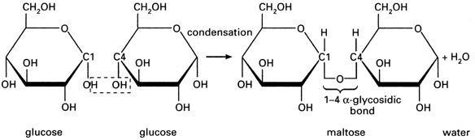
Glycosidic Bonds
a closer look
H
H

Slide 13
Carbohydrates → Energy… How?
Carbohydrates → Enter the body
and broken down into monosaccharides using a reaction.
Monosaccharides converted to if not already in form
Single molecules can now move throughout the body by
Small Intestine → Liver → Blood Stream
Concentration Gradient → Taken up by cells
Glucose used for energy, liver stores excess, beyond excess turned into

Slide 14
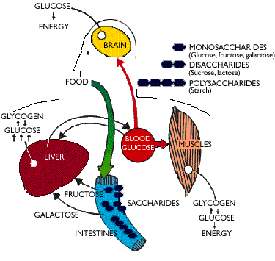
The Carbohydrate Path
Where does the glucose go once in the bloodstream?
What does the liver do?
Food → Small Intestine → Monosaccharides → Glucose → Blood Stream → Cells → Storage

Slide 15
Carbohydrates Introduction Review
Foods
Monosaccharides, Disaccharides, Polysaccharides
Bonds and Reactions
Glycosidic bonds formed by dehydration reactions. Broken by hydrolosis.
Energy
Carbohydrates broken into monosaccharides, converted to glucose, and used or stored in the body.
Representation
Cyclic or linear

