Slide 1
Probability Jeopardy! (kinda.)

Slide 2
INSTRUCTIONS
Each column of desks will form a team.
  Window column, computer column, etc.
Arrange desks facing each other so that everyone can see the board. (Face side walls)
Problems will be posted one at a time. Work as a team to come up with the correct answer!
Each team will have one whiteboard on which they will write the team’s final answers.

Slide 3
EVERY TEAM MUST CHOOSE A NAME!
Computer Column:
2nd Column:
3rd Column:
4th Column:
5th Column:
Window Column:

Slide 4
Given P(A) = 0.2 and P(B) = 0.4:
1.) If A and B are independent events,
what is P(A and B)?
2.) If P(A|B) = 0.1,
what is P(A and B)?

Slide 5
Only about 14% of senior citizens (age 65+) get the flu each year.
However, about 24% of people under 65 get the flu each year.
In the general population, there are 12.5% senior citizens.
3.) What is the probability that a person selected at random from the general population is a senior citizen who will get the flu this year?

Slide 6
Only about 14% of senior citizens (age 65+) get the flu each year.
However, about 24% of people under 65 get the flu each year.
In the general population, there are 12.5% senior citizens.
4.) What is the probability that a person selected at random from the general population is a person under age 65 who will get the flu this year?

Slide 7
Supermarket Customer Loyalty by Region of the U.S.
 | < 1 year | 1-2 years | 3-4 years | 5-9 years | 10-14 years | 15+ years | Row Total
East | 32 | 54 | 59 | 112 | 77 | 118 | 452
Midwest | 31 | 68 | 68 | 120 | 63 | 173 | 523
South | 53 | 92 | 93 | 158 | 106 | 158 | 660
West | 41 | 56 | 67 | 78 | 45 | 86 | 373
Column Total | 157 | 270 | 287 | 468 | 291 | 535 | 2008
5.) What is the probability that a customer chosen at random has been loyal 10 to 14 years?

Slide 8
Supermarket Customer Loyalty by Region of the U.S.
 | < 1 year | 1-2 years | 3-4 years | 5-9 years | 10-14 years | 15+ years | Row Total
East | 32 | 54 | 59 | 112 | 77 | 118 | 452
Midwest | 31 | 68 | 68 | 120 | 63 | 173 | 523
South | 53 | 92 | 93 | 158 | 106 | 158 | 660
West | 41 | 56 | 67 | 78 | 45 | 86 | 373
Column Total | 157 | 270 | 287 | 468 | 291 | 535 | 2008
6.) What is the probability that a customer chosen at random has been loyal 10 to 14 years, given they are from the east?

Slide 9
Supermarket Customer Loyalty by Region of the U.S.
 | < 1 year | 1-2 years | 3-4 years | 5-9 years | 10-14 years | 15+ years | Row Total
East | 32 | 54 | 59 | 112 | 77 | 118 | 452
Midwest | 31 | 68 | 68 | 120 | 63 | 173 | 523
South | 53 | 92 | 93 | 158 | 106 | 158 | 660
West | 41 | 56 | 67 | 78 | 45 | 86 | 373
Column Total | 157 | 270 | 287 | 468 | 291 | 535 | 2008
7.) What is the probability that a customer chosen at random has been loyal at least 10 years?

Slide 10
Supermarket Customer Loyalty by Region of the U.S.
 | < 1 year | 1-2 years | 3-4 years | 5-9 years | 10-14 years | 15+ years | Row Total
East | 32 | 54 | 59 | 112 | 77 | 118 | 452
Midwest | 31 | 68 | 68 | 120 | 63 | 173 | 523
South | 53 | 92 | 93 | 158 | 106 | 158 | 660
West | 41 | 56 | 67 | 78 | 45 | 86 | 373
Column Total | 157 | 270 | 287 | 468 | 291 | 535 | 2008
8.) What is the probability that a customer chosen at random has been loyal at least 10 years, given they are from the west?

Slide 11
Supermarket Customer Loyalty by Region of the U.S.
 | < 1 year | 1-2 years | 3-4 years | 5-9 years | 10-14 years | 15+ years | Row Total
East | 32 | 54 | 59 | 112 | 77 | 118 | 452
Midwest | 31 | 68 | 68 | 120 | 63 | 173 | 523
South | 53 | 92 | 93 | 158 | 106 | 158 | 660
West | 41 | 56 | 67 | 78 | 45 | 86 | 373
Column Total | 157 | 270 | 287 | 468 | 291 | 535 | 2008
9.) What is the probability that a customer chosen at random is from the west, given that they have been loyal less than one year?

Slide 12
Supermarket Customer Loyalty by Region of the U.S.
 | < 1 year | 1-2 years | 3-4 years | 5-9 years | 10-14 years | 15+ years | Row Total
East | 32 | 54 | 59 | 112 | 77 | 118 | 452
Midwest | 31 | 68 | 68 | 120 | 63 | 173 | 523
South | 53 | 92 | 93 | 158 | 106 | 158 | 660
West | 41 | 56 | 67 | 78 | 45 | 86 | 373
Column Total | 157 | 270 | 287 | 468 | 291 | 535 | 2008
10.) What is the probability that a customer chosen at random is from the south, given that they have been loyal less than one year?

Slide 13
Supermarket Customer Loyalty by Region of the U.S.
 | < 1 year | 1-2 years | 3-4 years | 5-9 years | 10-14 years | 15+ years | Row Total
East | 32 | 54 | 59 | 112 | 77 | 118 | 452
Midwest | 31 | 68 | 68 | 120 | 63 | 173 | 523
South | 53 | 92 | 93 | 158 | 106 | 158 | 660
West | 41 | 56 | 67 | 78 | 45 | 86 | 373
Column Total | 157 | 270 | 287 | 468 | 291 | 535 | 2008
11.) What is the probability that a customer chosen at random has been loyal 1 or more years, given that they are from the east?

Slide 14
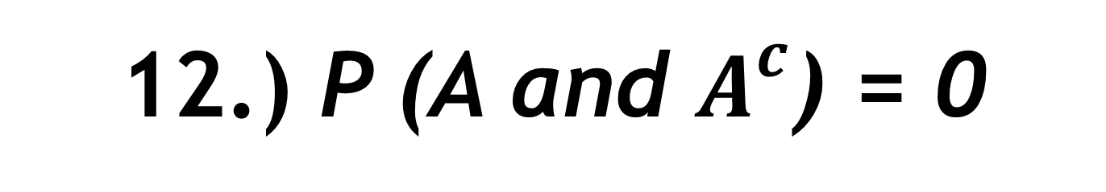
Assume A and B are events such that 0 < P(A) < 1 and 0 < P(B) < 1.
Answer TRUE or FALSE with a brief explanation.
12.) P (A and $A^{c}$) = 0

Slide 15
Assume A and B are events such that 0 < P(A) < 1 and 0 < P(B) < 1.
Answer TRUE or FALSE with a brief explanation.
13.) P (A and B) ≤ P(A)

Slide 16
Assume A and B are events such that 0 < P(A) < 1 and 0 < P(B) < 1.
Answer TRUE or FALSE with a brief explanation.
14.) If A and B are both mutually exclusive and independent, then at least one of P(A) or P(B) must be zero.

Slide 17


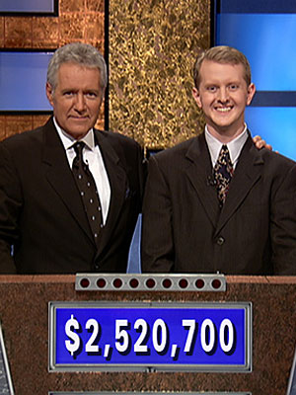

GAME OVER!!!!

