Slide 1
A Learning Response System:
Socrative

Slide 2
Welcome!
Elizabeth Wood, Ball State Student
  Elementary and Special Education
Matthew Stuve, Ph.D.
  Director and Associate Professor of
  Educational Psychology
Natalie Schelling, Graduate Assistant
  Ph.D. Educational Psychology

Slide 3
Agenda
Learning response systems
Socrative
Activities

Slide 4
Learning Objectives
The teacher will define learning response system.
The teacher will utilize Socrative as a teacher.
The teacher will utilize Socrative as a student.

Slide 5
Learning Response System
Any tool or system that promotes direct student responses during classroom instruction
  Quick
  Responsive
  Engages the learner on the fly
  Allows teachers to see data and make decisions about instruction

Slide 6
Purposes
Quizzes (including scoring)
Surveys (quizzes with names disabled)
Checks for understanding
Quick writes
Engages them in the flow of the lesson
Formative assessment

Slide 7
Benefits
Increases motivation
Builds conceptual structure
Increases participation
Assesses prior knowledge

Slide 8
Some General Notes About LRSs
Be aware of anonymity
  Make sure you don’t use identifying information in an online service
Use Socrative for simple quizzes and inputs that you might put into Sycamore later
Avoid using Socrative for more formal, summative tests that need the full power and alignments of your Learning Management System

Slide 9
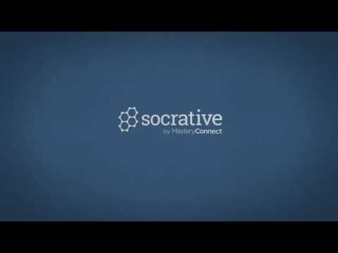
Socrative.com

Slide 10
Socrative Apps and Platforms
Apps for devices
  Teacher App
  Student Appf
Website for laptops

Slide 11
Student “Login” is a Room Name
Open your Socrative Student app
Type in WOOD4784 for Room Name
Answer this question
No actual student “login”

Slide 12
Answer this Question
True or False:
Socrative can be used on any device.
What was the purpose of asking that question at this time?

Slide 13
Using Socrative: App or Browser
iPads
Computers (via any browser)
iPhones
Chromebooks (via Chrome browser)
Android devices
iOS
Windows 10 Apps

Slide 14
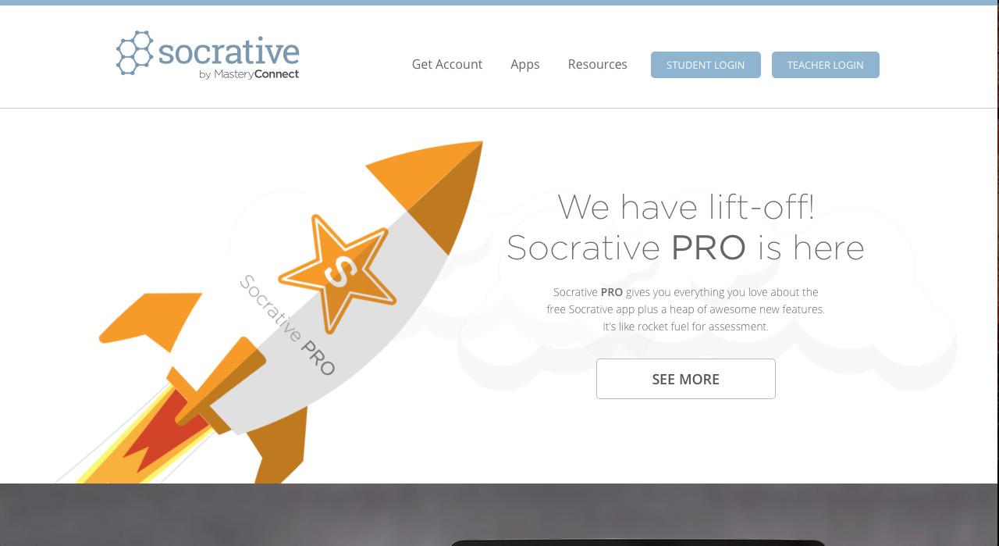
Teacher’s Side
Based off of the website
Other devices
  Student or teacher app

Slide 15
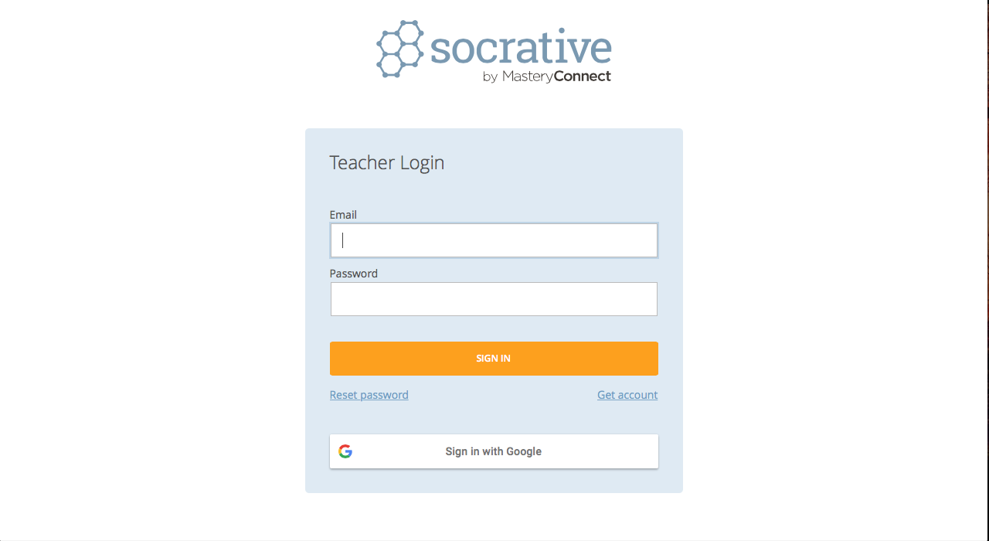
Teacher Login

Slide 16
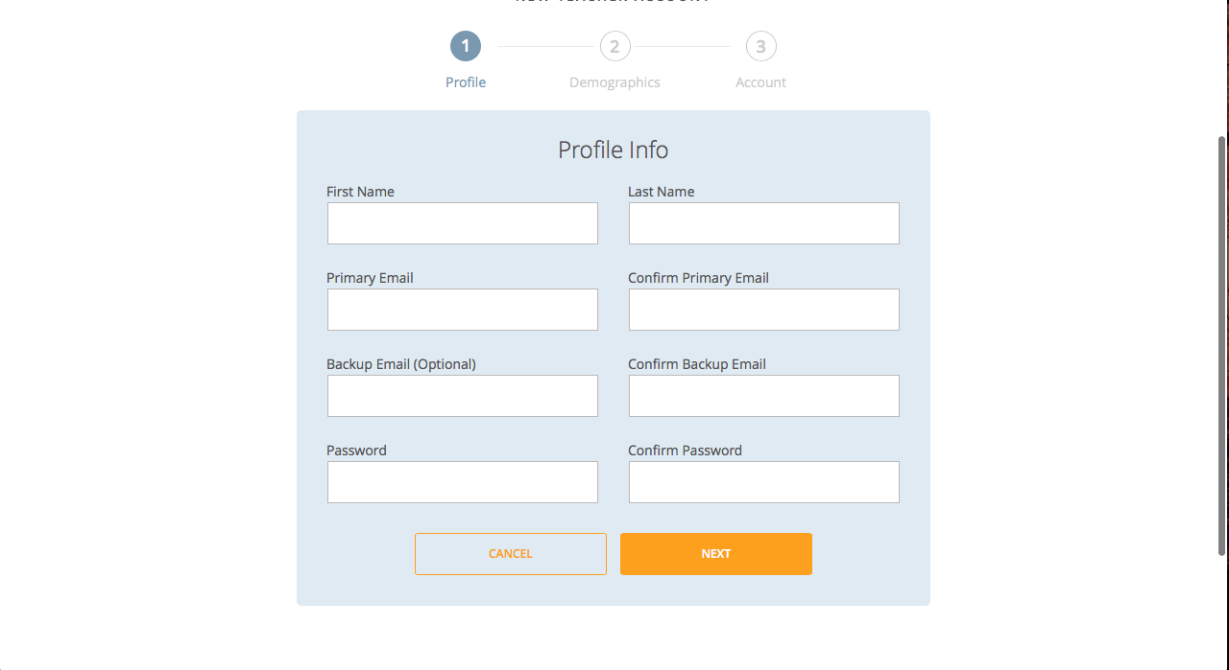
Teacher’s Profile

Slide 17
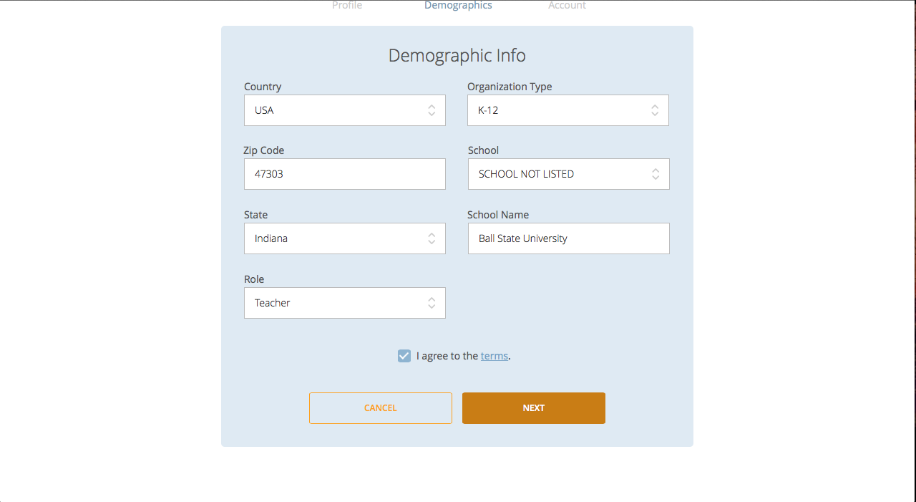
Teacher’s Demographics

Slide 18
Quick Questions
“On the fly questions”
Assess your students quickly
  Checking for understanding
Types
  Multiple Choice
  True/False
  Short-answer

Slide 19
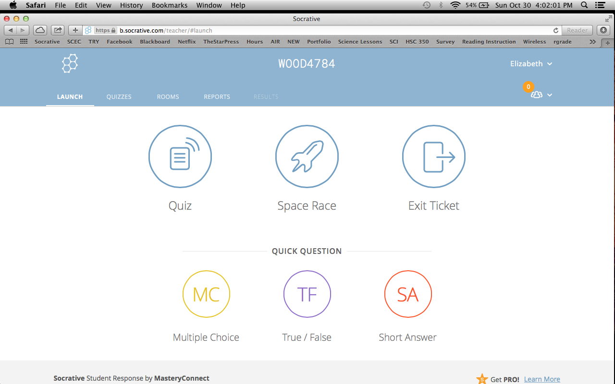
Students are anonymous
Launch Quick Questions

Slide 20
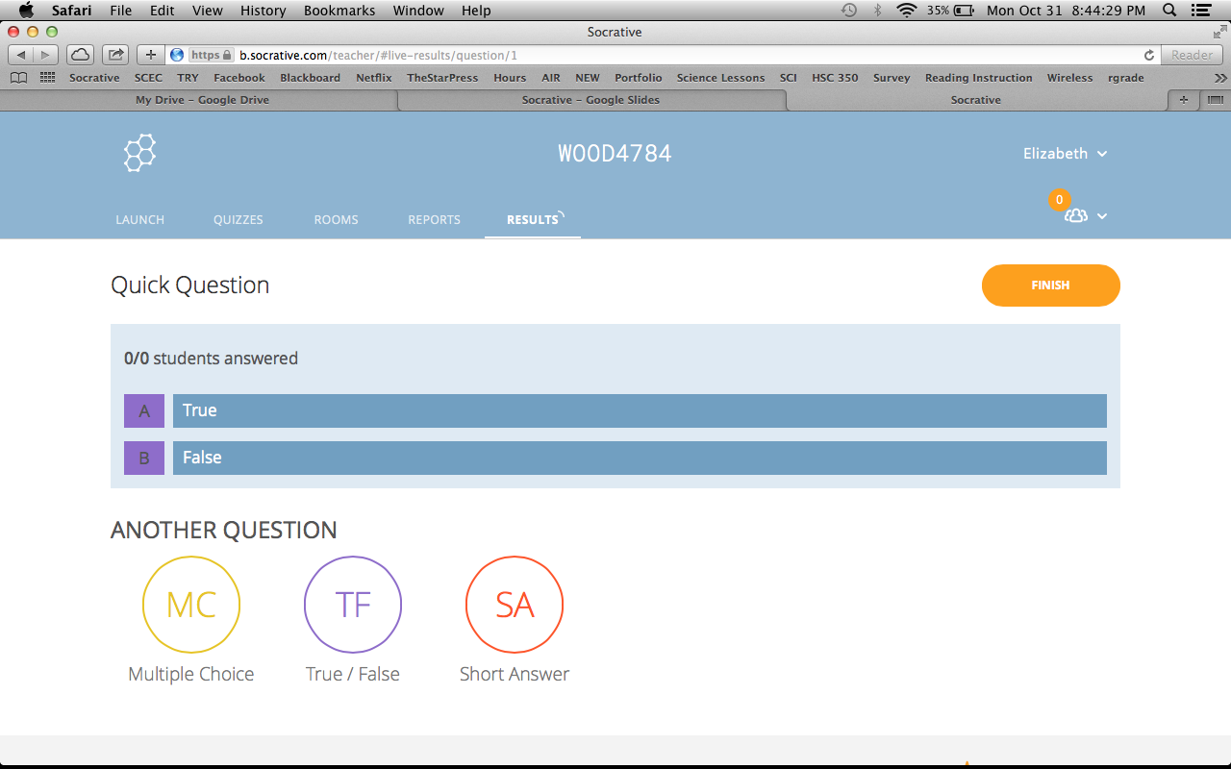
Quick Question: Multiple Choice

Slide 21
Number of students logged in
Up to 50 students
Socrative Pro- up to 150 students
Class Count

Slide 22
Quizzes
Create and edit your quizzes
Attach standards
Sort your quizzes
  Date
  Standard
  Name
Share quizzes
  Pro Socrative
Import quizzes
  Unique number
Launch quizzes

Slide 23
Quizzes

Slide 24
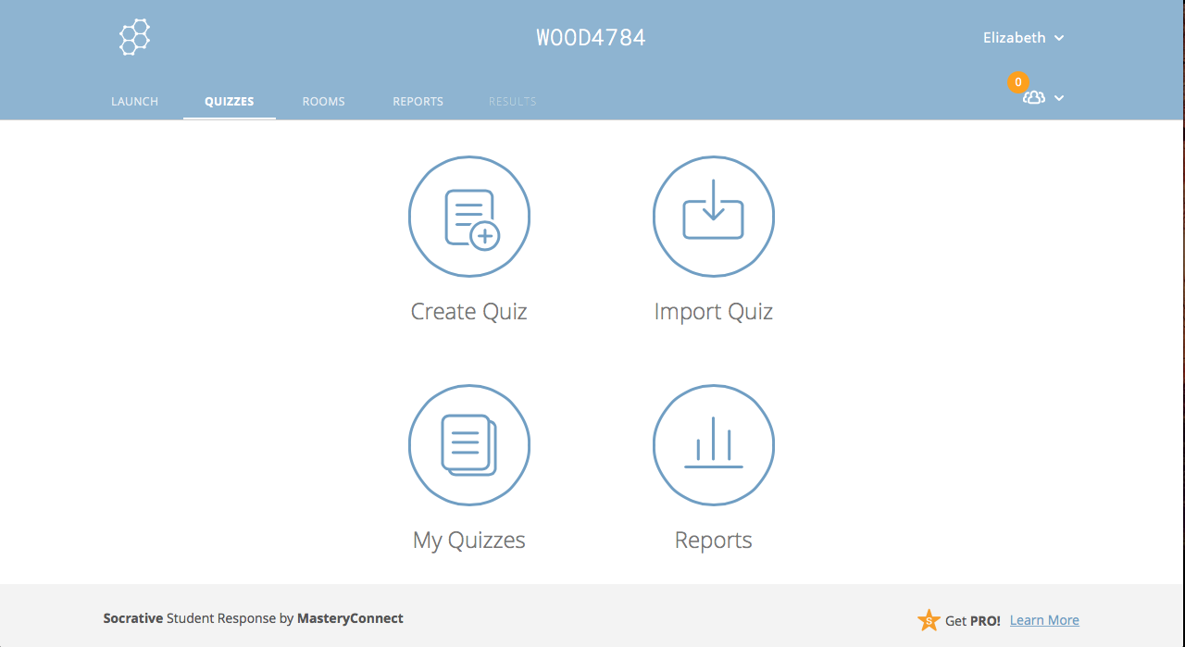
Quizzes

Slide 25
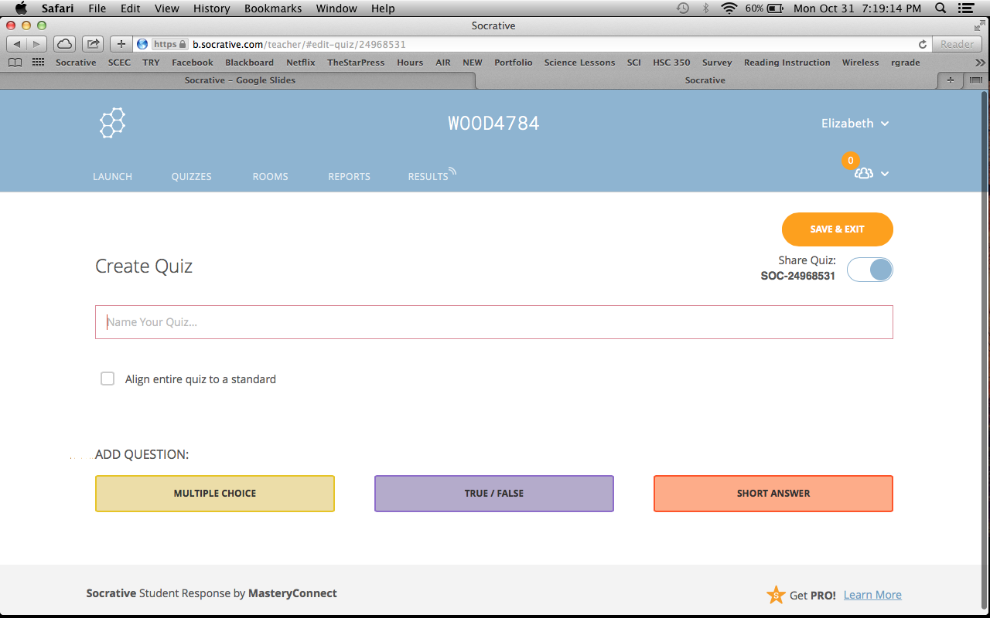
Create Quiz

Slide 26
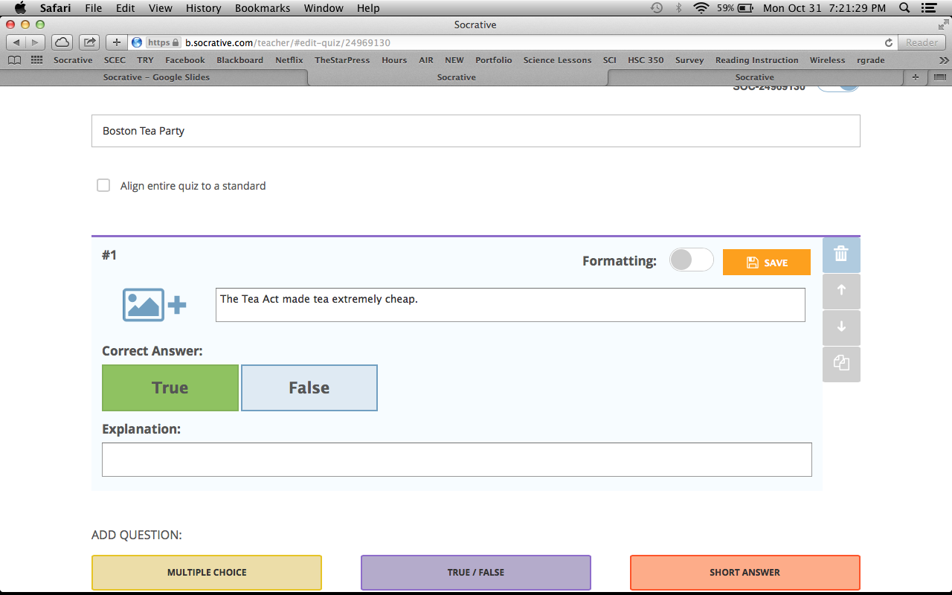
Making the Quiz

Slide 27
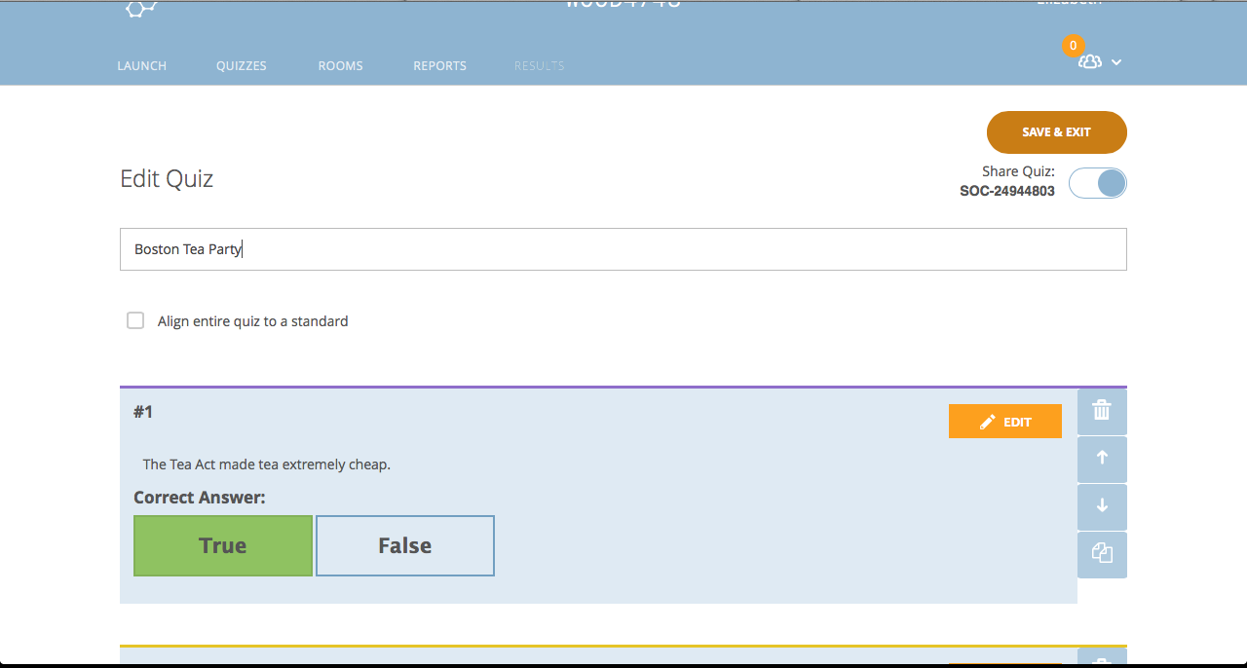
Save and Exit

Slide 28
Launch Quiz

Slide 29
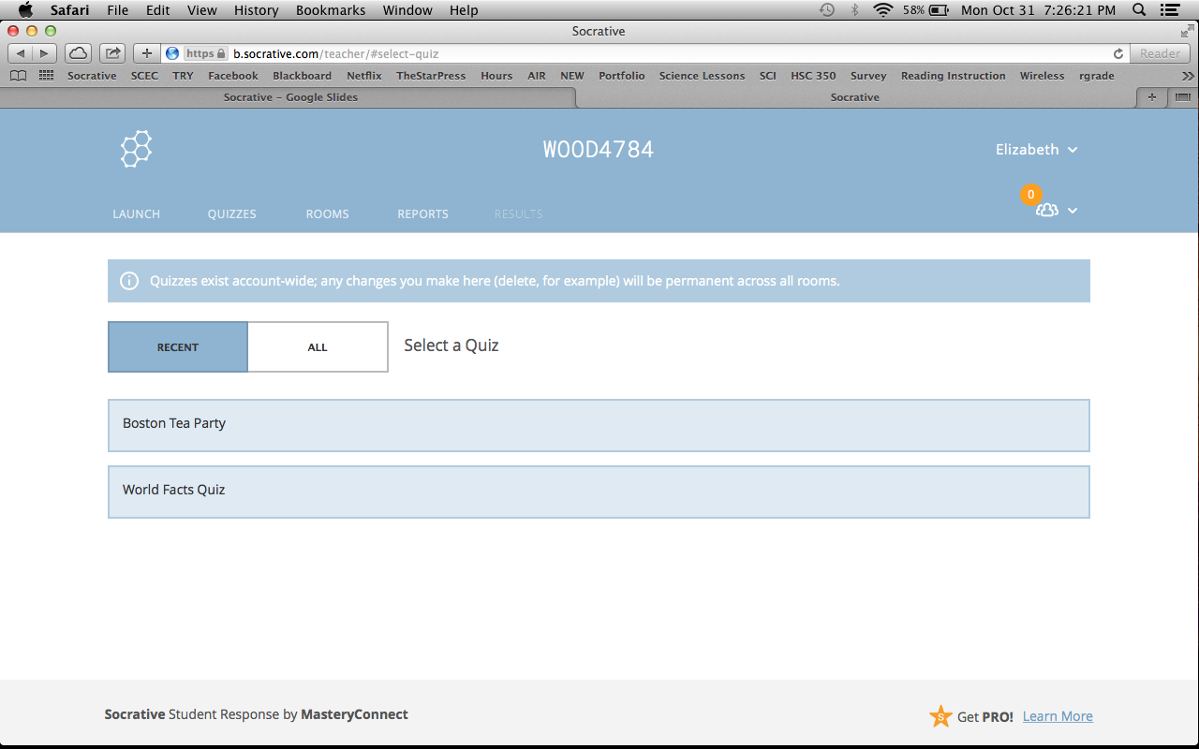
Select a Quiz

Slide 30
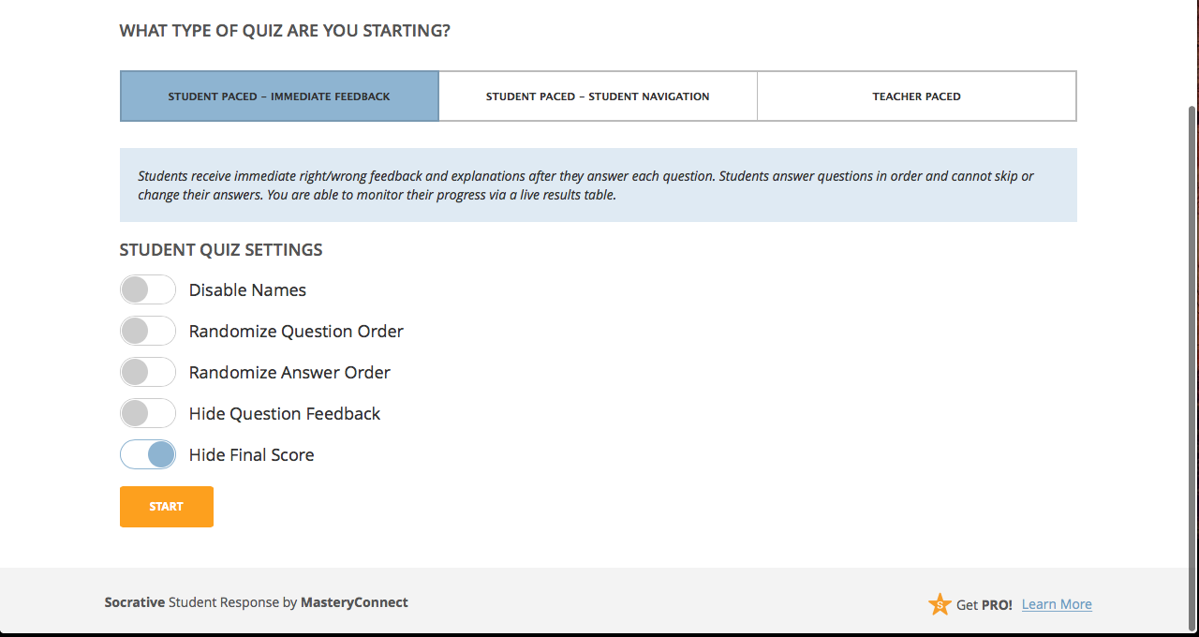
Student Paced - Immediate Feedback

Slide 31
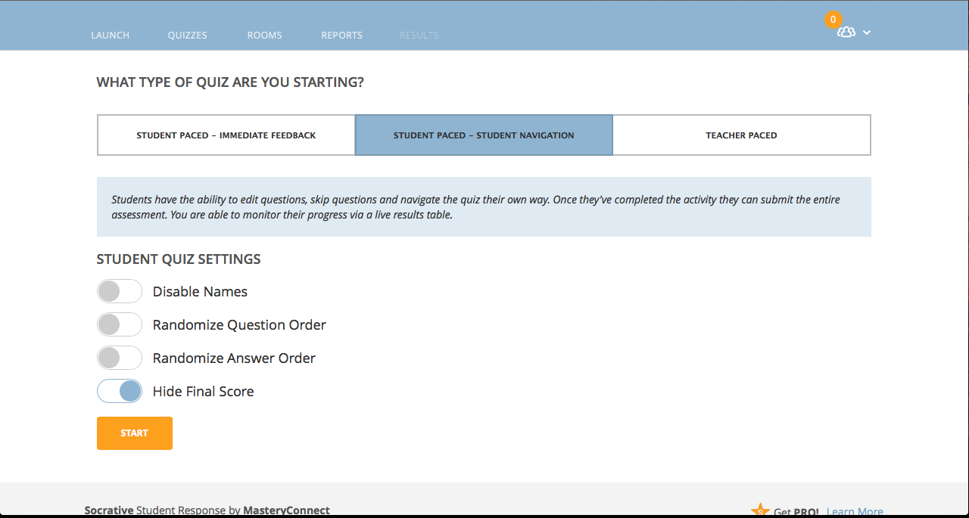
Student Paced - Student Navigation

Slide 32
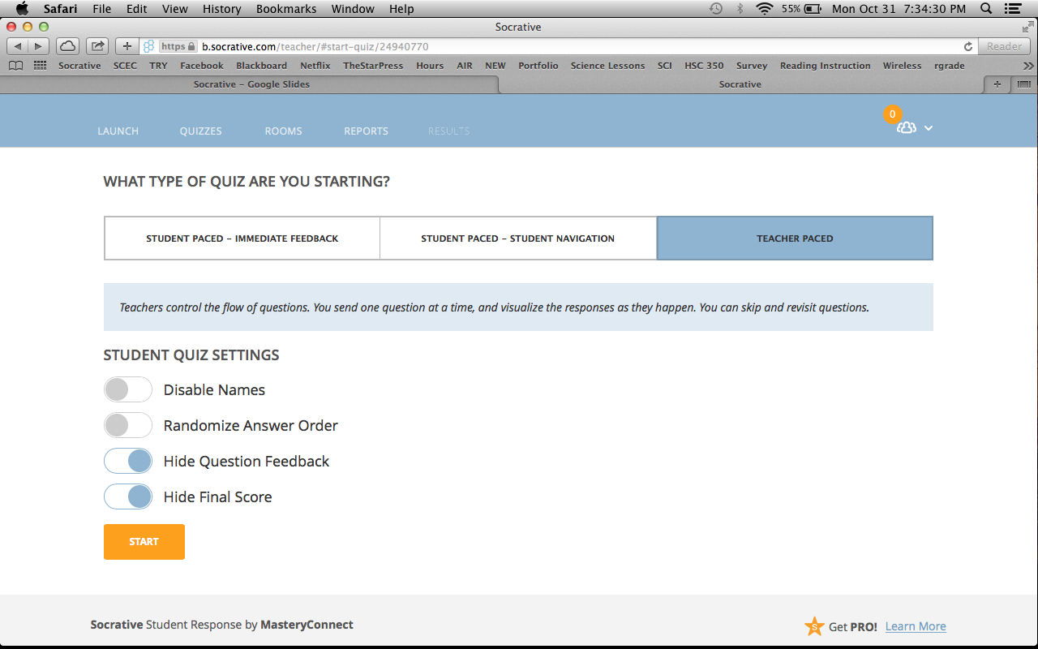
Student Paced - Teacher Paced

Slide 33
Import Quiz

Slide 34
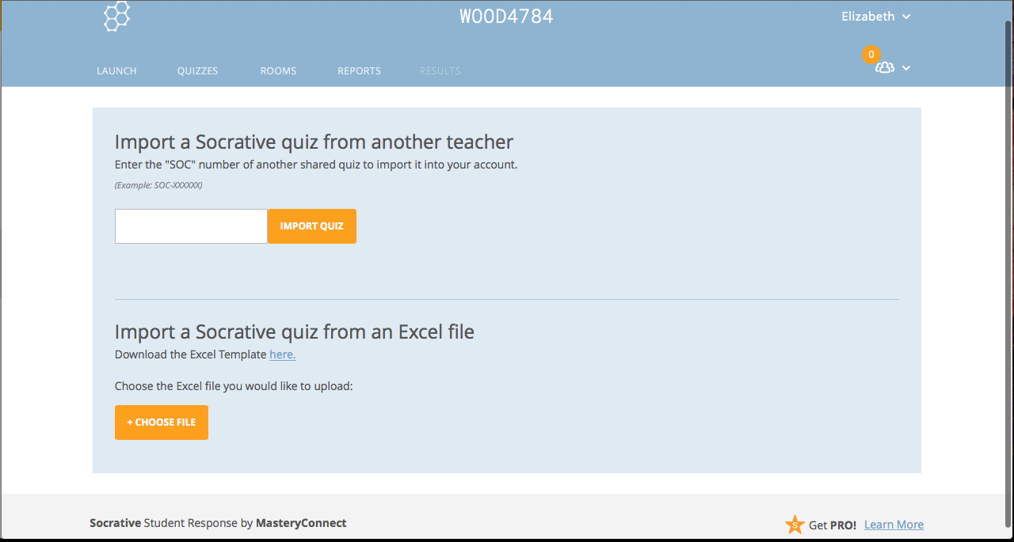
Import Quiz

Slide 36
Import Quiz

Slide 37
Rooms

Slide 38
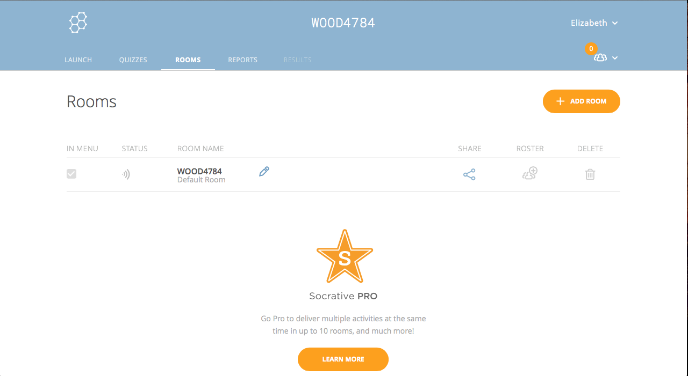
Rooms
You can edit your room name.
You can only have one room and rosters are not allowed unless you have Socrative Pro.

Slide 39
Reports
Displays a list of all of your assessment items
  Name
  Date
  Time
  Standard
  Results

Slide 40
Reports

Slide 41
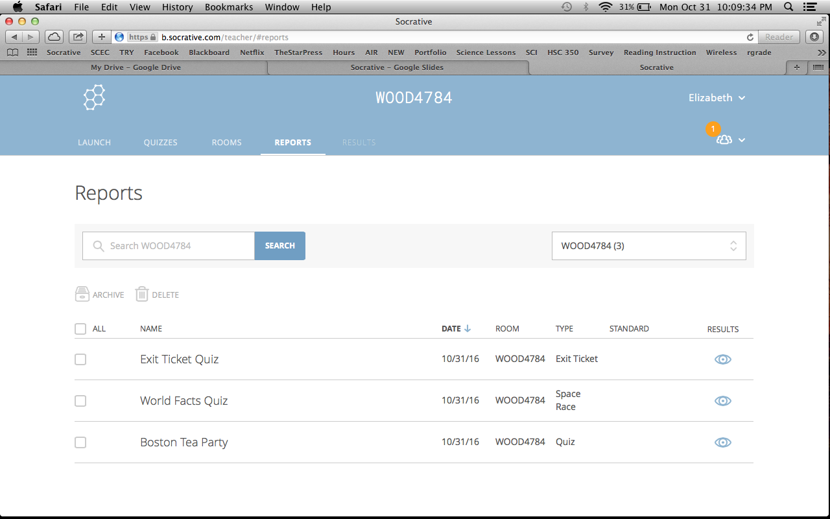
Reports

Slide 42
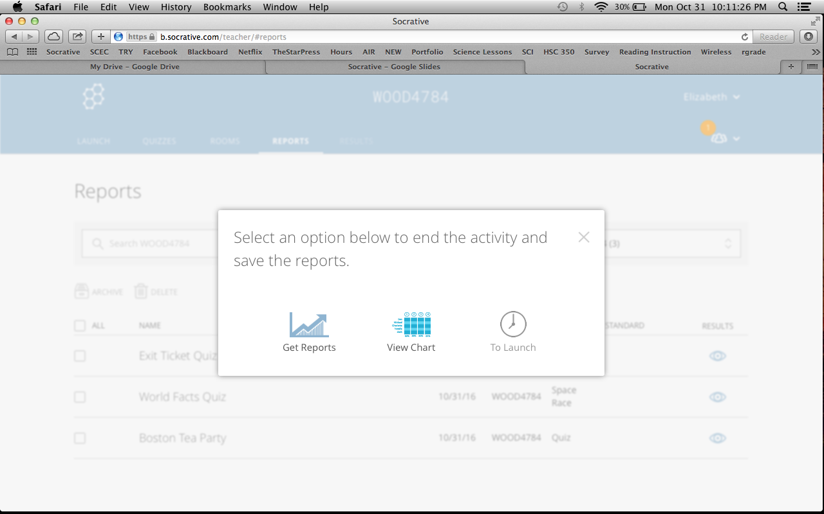
View Chart

Slide 43
Results
Instant feedback
Visualize students’ understanding
  Green - answered correctly
  Red - answered incorrectly
Detailed instruction
  Percentage of each question
Download or email reports -> Transfer to grade book
  Question type
  Individual student
  Class
Group students based on who needs more help or who needs more advanced content

Slide 44
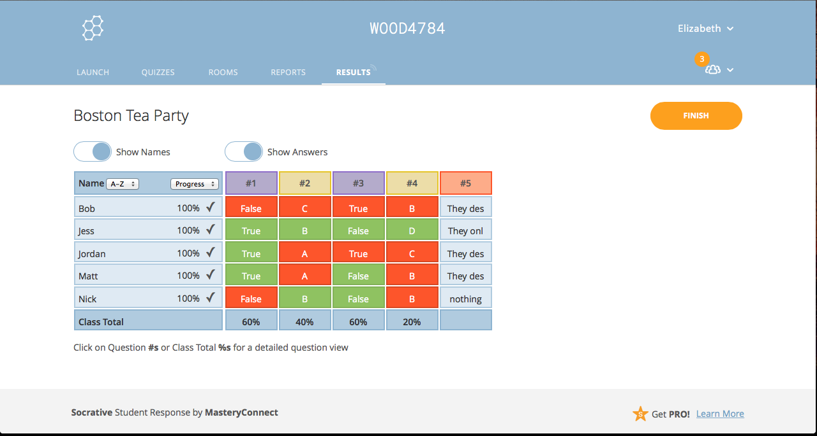
Results

Slide 45
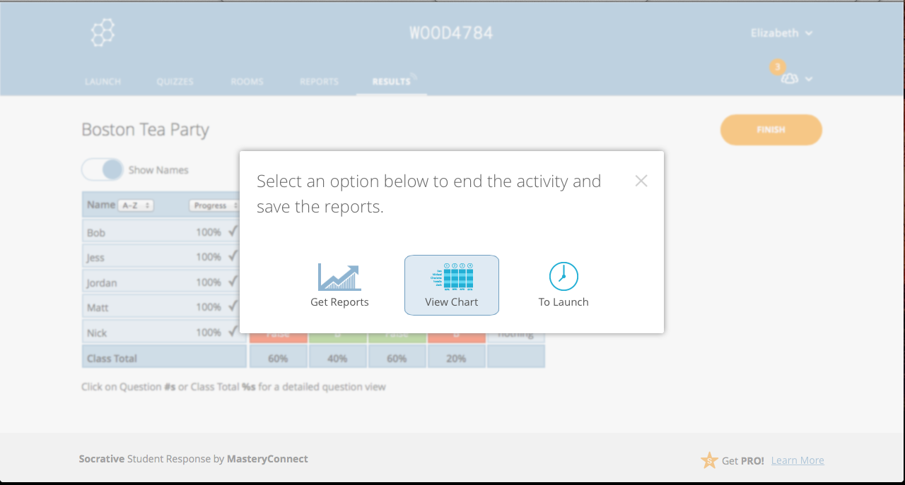
Get Reports

Slide 46
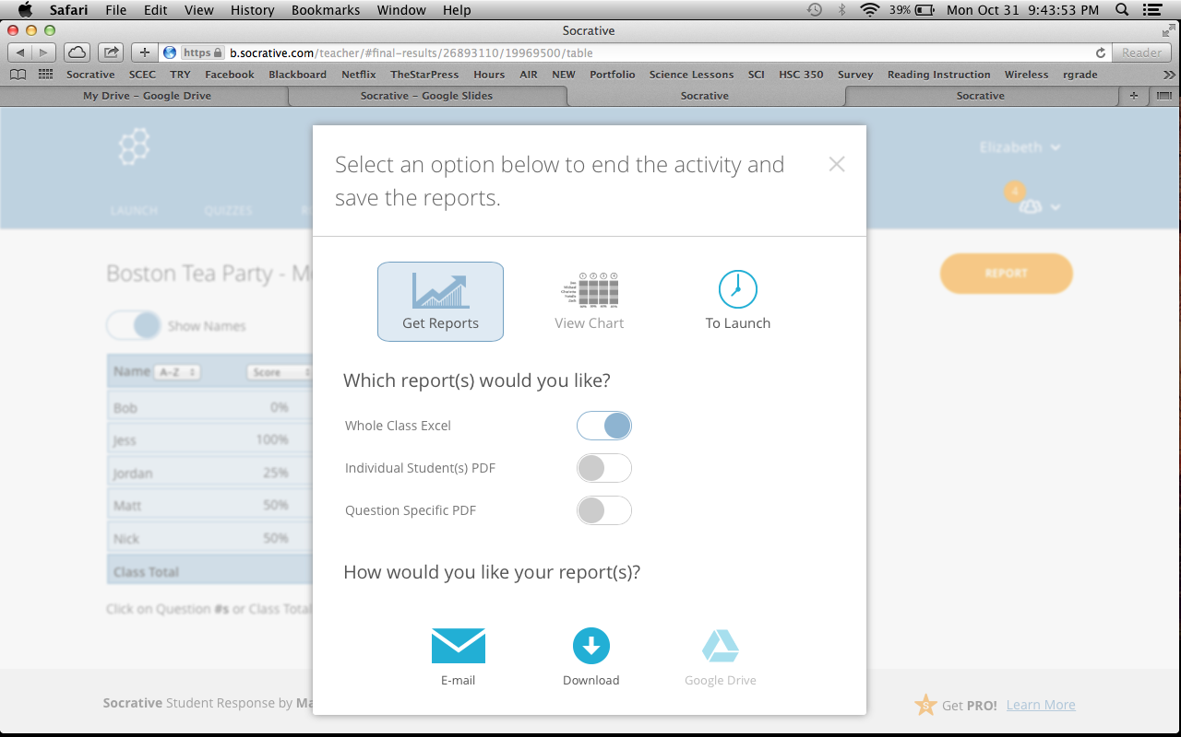
Export

Slide 47
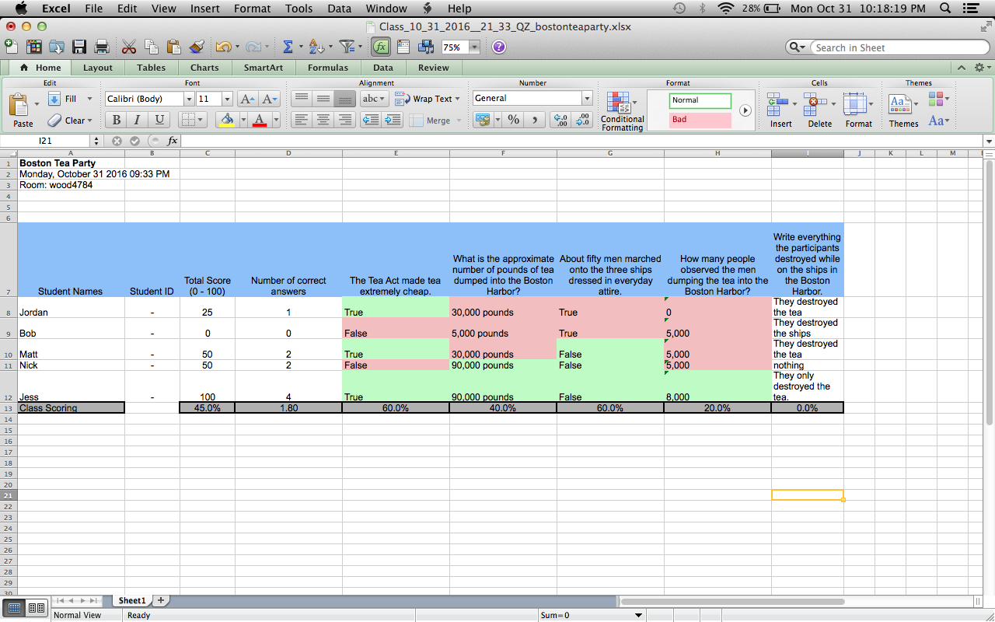
Excel

Slide 48
Activity - Quizzes
Create a quiz in pairs
Test our quiz
Look at the results
Share our experiences and thoughts

Slide 49
Space Race
Fast and fun way to assess students
Engages your students in healthy competition
Access results after the race

Slide 50
Launch Space Race

Slide 51
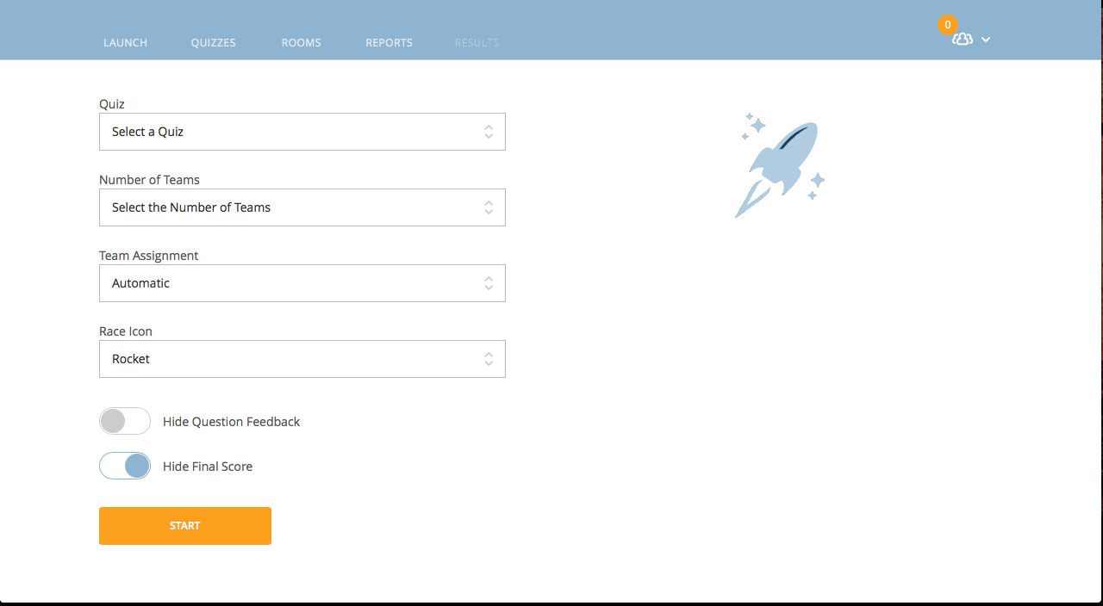
Creating Space Race

Slide 52
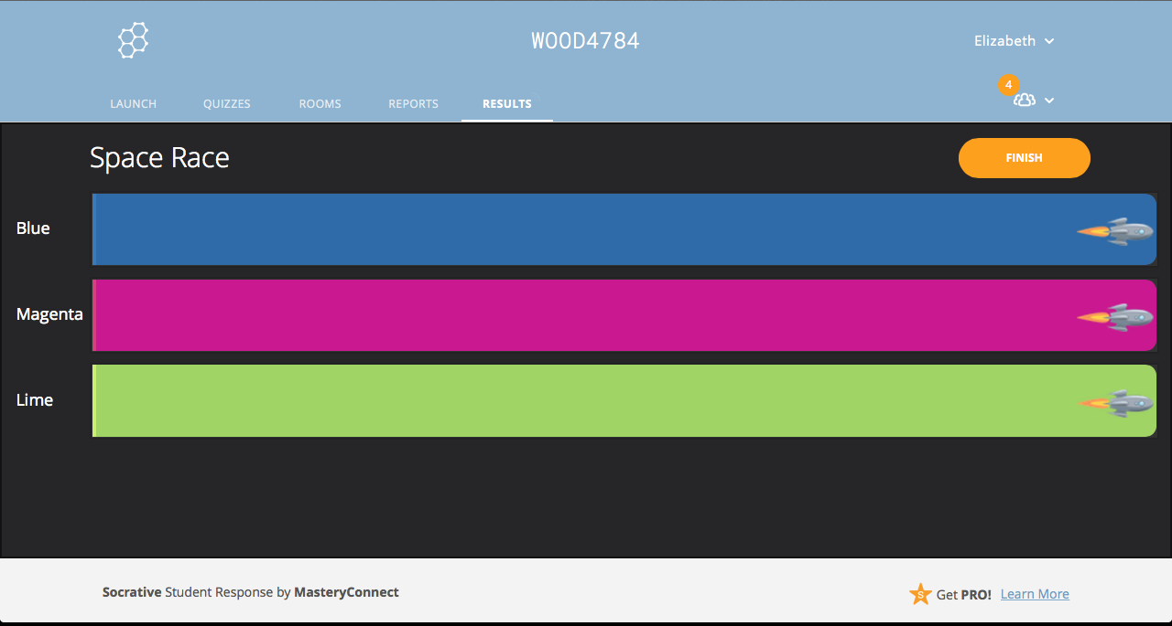
Space Race

Slide 53
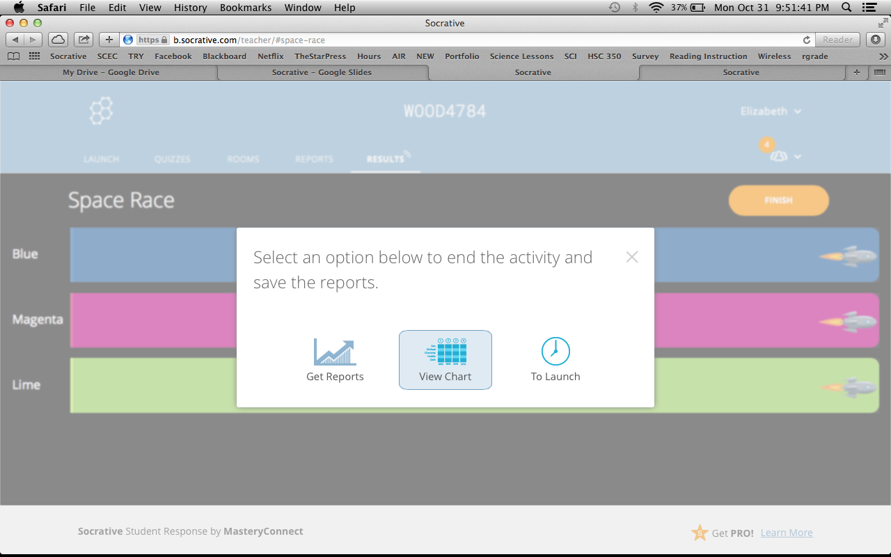
View Chart
Let’s test this!

Slide 54
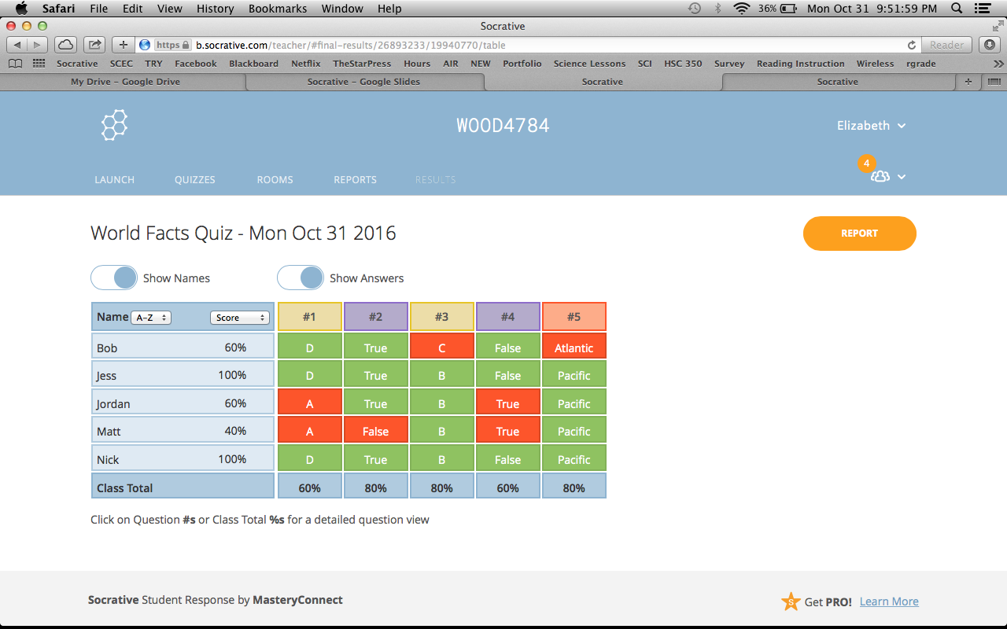
Results

Slide 55
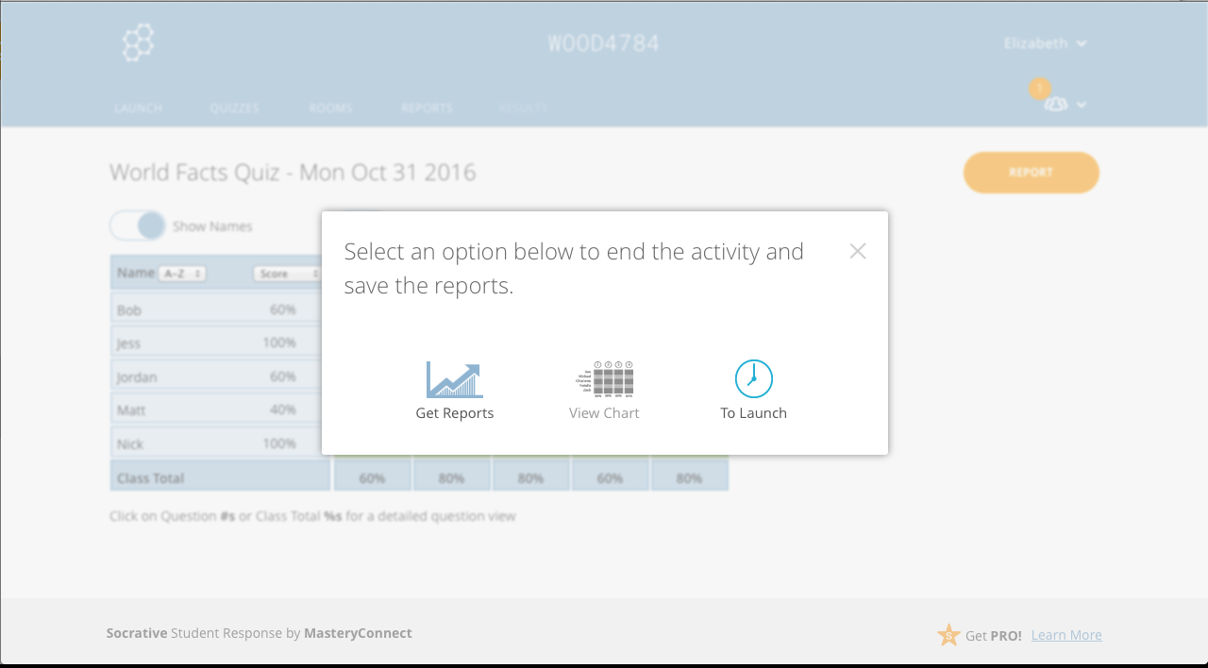
Get Reports

Slide 56
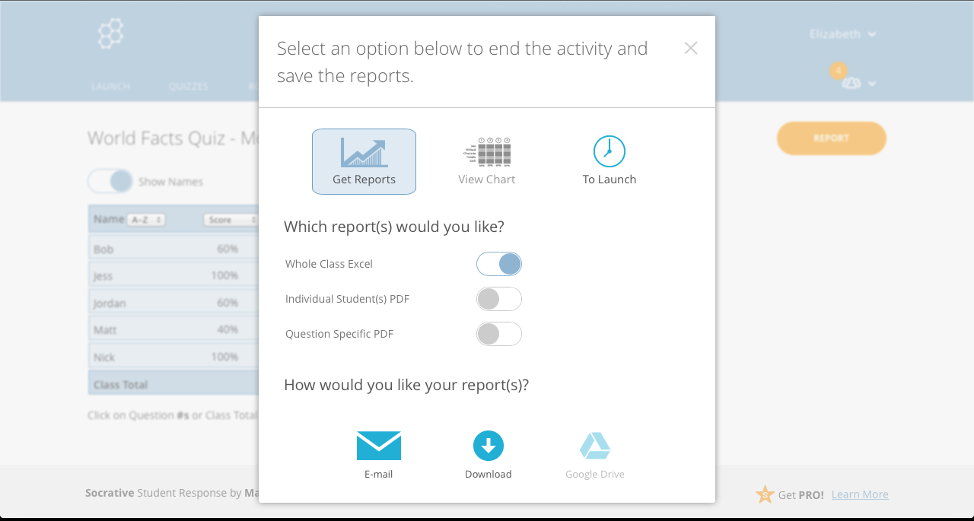
Export

Slide 57
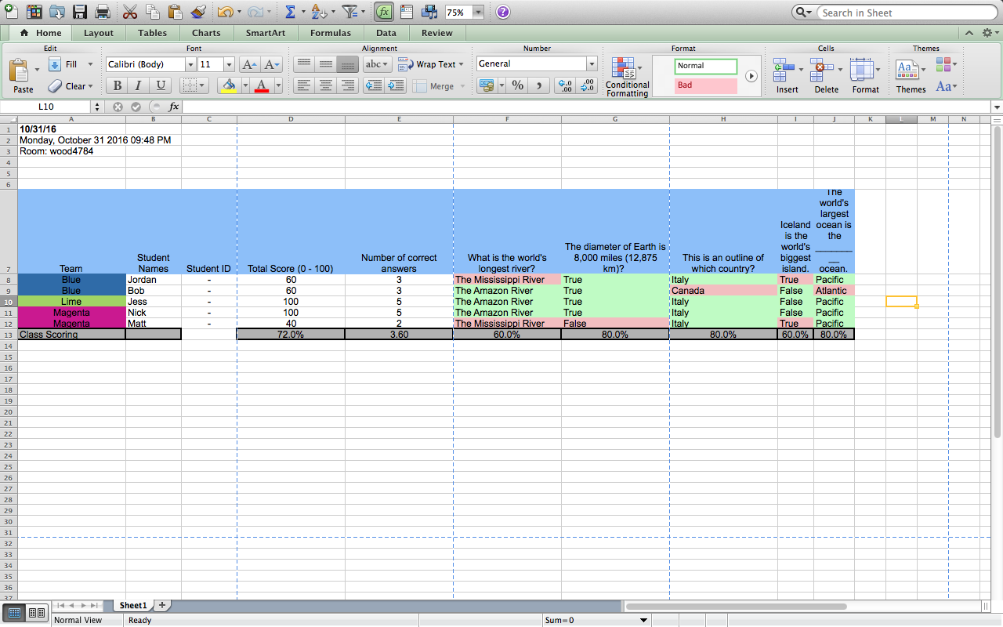
Excel

Slide 58
Exit Tickets
A pre-existing input type in Socrative, with the same three questions
  Tells us who understand the material today
  What the student learned today
  Teacher’s question
    Can state verbally or write it somewhere that all students can see
Build your own as a quiz

Slide 59
Launch
Exit Ticket

Slide 60
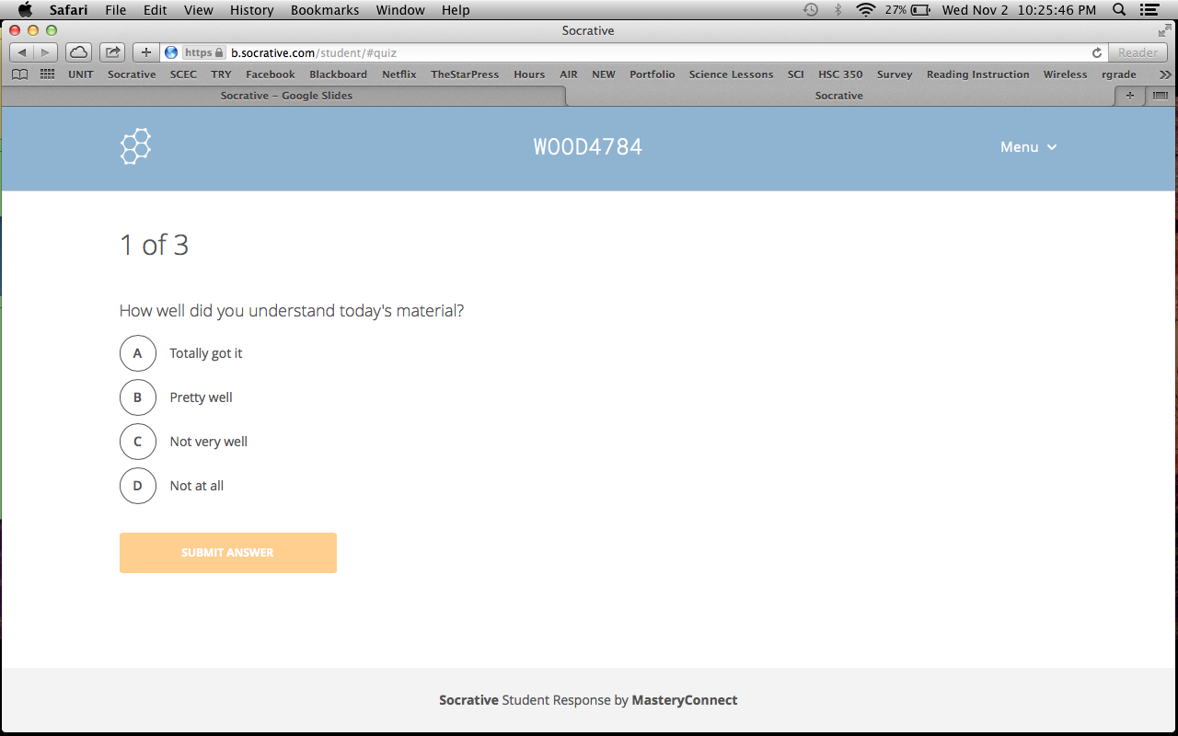
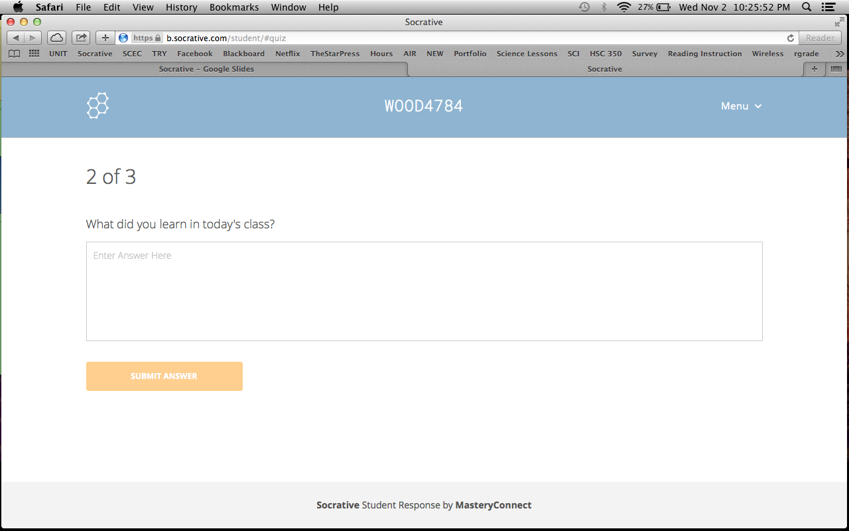


Slide 61
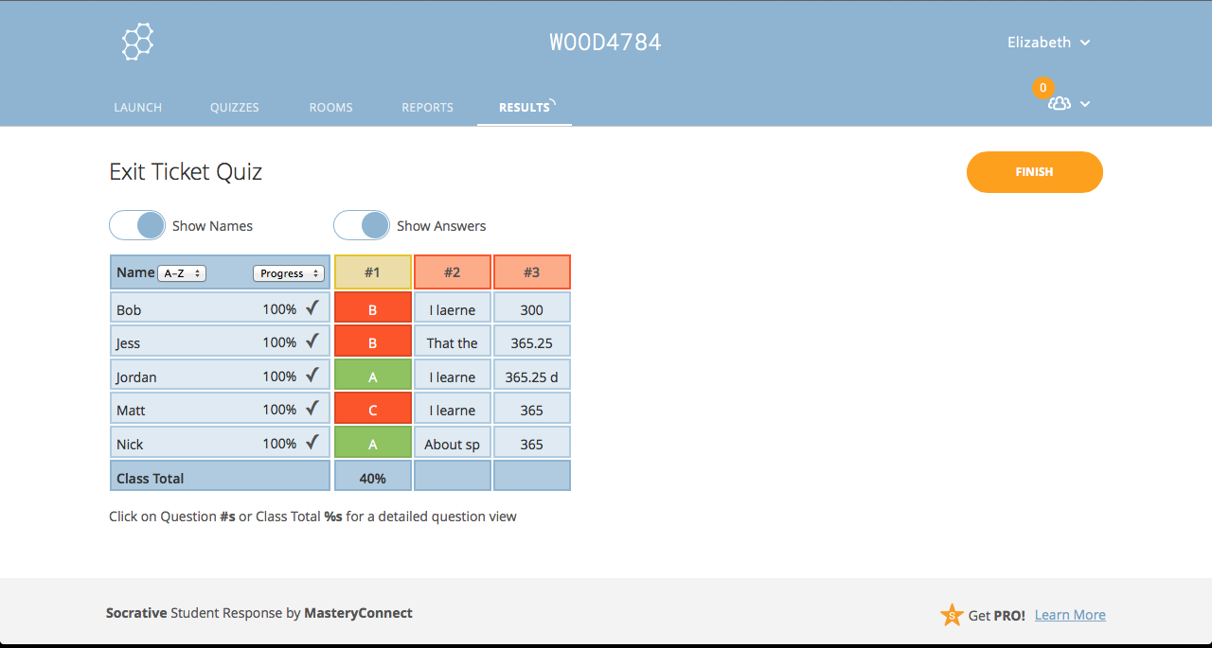
Results

Slide 62
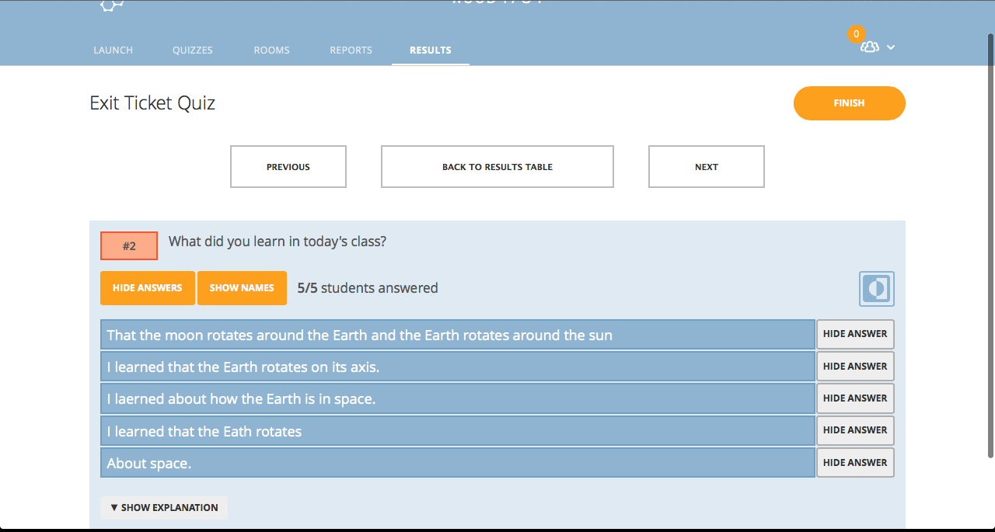
Answers to Question 2

Slide 63
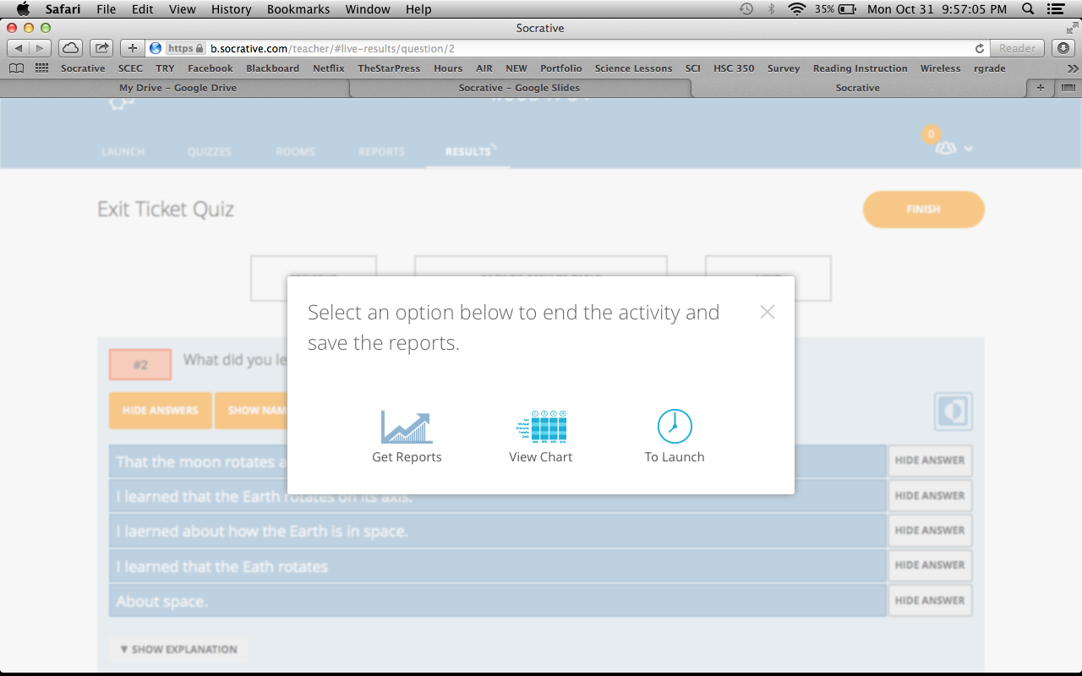
Get Reports

Slide 64
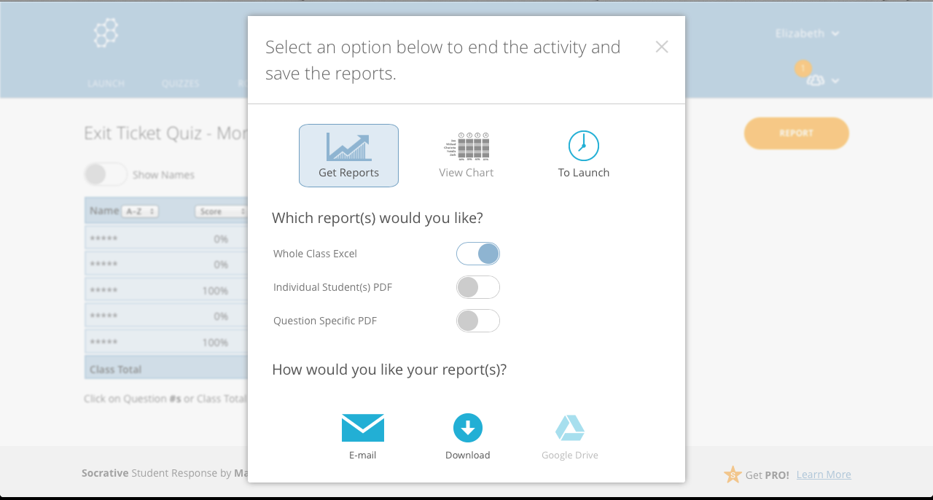
Export

Slide 65
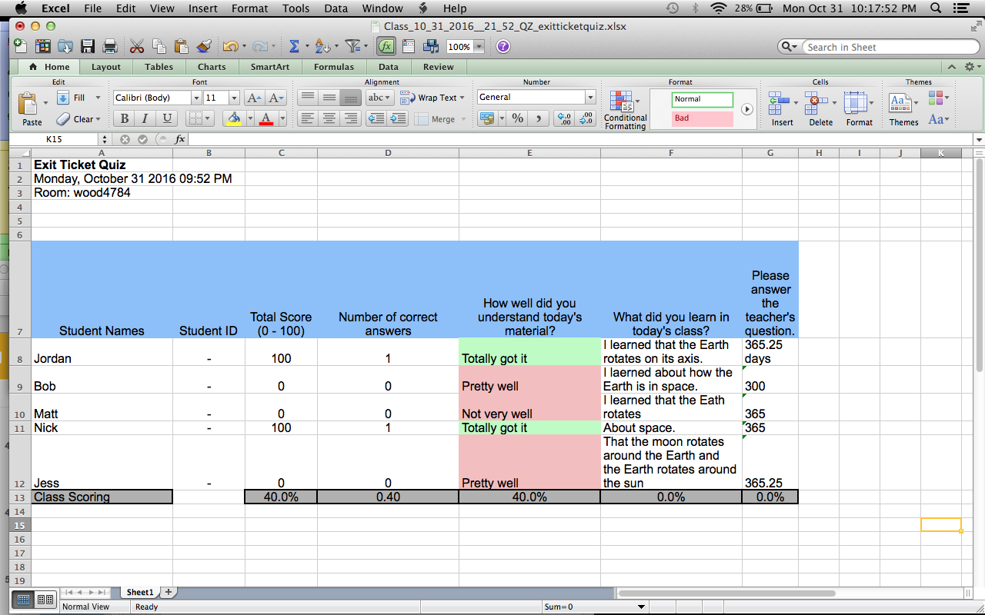
Excel

Slide 66
Thank you!

