Slide 1
The Chemistry of Life
By John Doe and Jane Doe

Slide 2
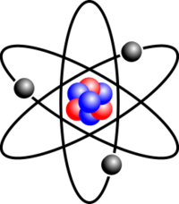
The Nature of Matter
The nature of matter explains what protons, neutrons, electrons, atoms, and molecules are.
An atom is matter that is not able to be cut

Slide 3
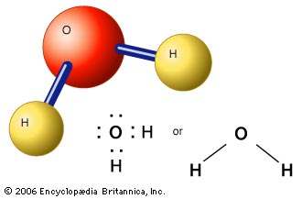
Properties of Water
Properties of water explains what water molecules, solutions, acids, bases, and pH are.
Water is a molecule made up of two hydrogen atoms and one oxygen atom

Slide 4
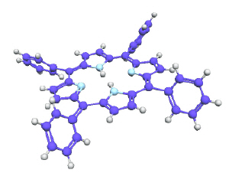
Carbon Compounds
Carbon compounds explain the Chemistry of Carbon, and biomolecules
The biomolecules are four organic compounds: carbohydrates, lipids, nucleic acids, and proteins

Slide 5
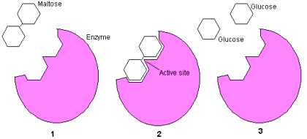
Chemical Reactions and Enzymes
Chemical reactions and enzymes explains what type of chemicals can have a reaction, and enzymes
Chemical reaction is a process that changes one set of chemicals into another set of chemicals
Enzymes are proteins that act as biological catalysts

