Slide 1

Ball STate MA Program in School Counseling
Dr. Theresa Kruczek
Program Director
tkruczek@bsu.edu
Madison Smith
Second-year student
mksmith7@bsu.edu

Slide 2
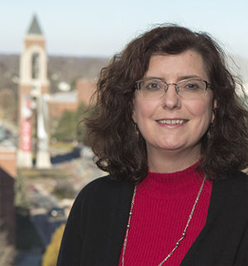
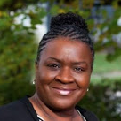
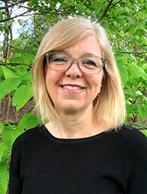
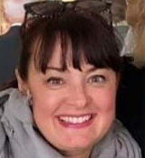

School Counseling Faculty
Theresa Kruczek,
Ph.D., HSPP & PSC
Interim Program Director and Field Experience Coordinator
Rachel Anderson,
M.Ed., (PSC)
Adjunct Professor
Kelly Dunn,
MS, LMHC, NCC, Indiana School Student Services Personnel
Adjunct Professor
Julie Maugherman,
MA, PSC
Adjunct
Professor

Slide 3
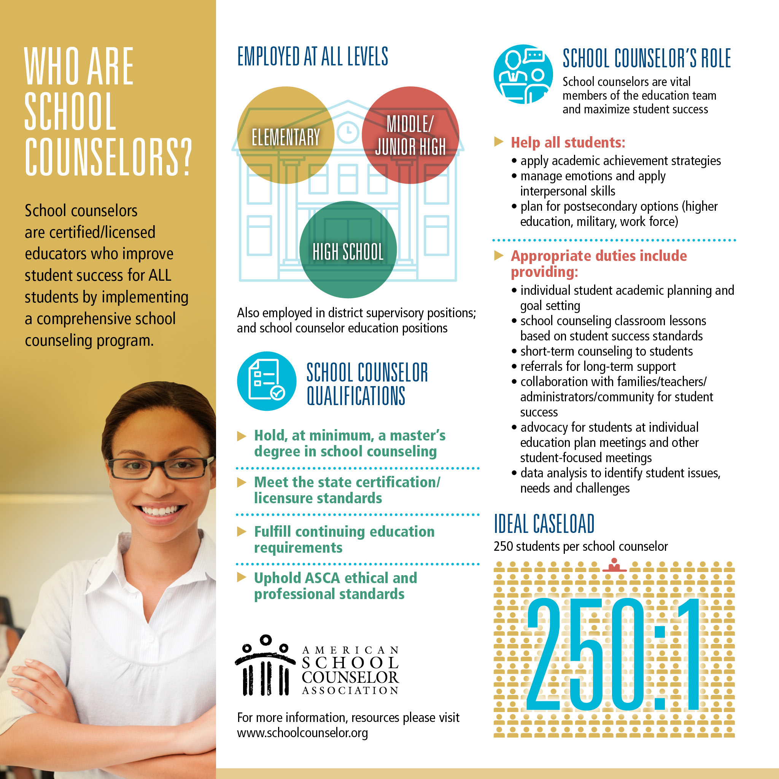

Slide 4
BSU School Counseling Program Goals
We prepare students to be able to:
Implement comprehensive school counseling programs that are
Based in the ASCA National Model
Centered on Educational Equity
Ethically and legally sound
Developmentally appropriate
focused on Academic, Personal/Social, and Career Development of all children
Be leaders and change agents in PK-12 schools

Slide 5


Slide 6
Training Components – 60 Credit Hours
Cohort model
2-year, full time; 3-4 years, part time.
Courses focus on comprehensive school counseling & educational equity
Field Experiences (800+ hours)
Begin in SCCO 600 (typically first year)
Practicum: SCCO 644 + SCCO 646 (200 hrs)
Internship: SCCO 695 (600 hrs)
Classes offered early afternoon/evening

Slide 7
Training Model for School Counseling
Grade
Classroom
Group
Individual
Community
Schoolwide
District
Family
Prevention & Intervention
Holistic Development
Culturally Responsive School Counseling
Collaboration
Accountability
Leadership
Advocacy
Counseling
Evidenced-Informed

Slide 8
Program Outcomes
Our graduates go on to be leaders in schools as professional school counselors.
100% pass rate for the SC Licensure Test in IN!
100% job placement for those entering into the workforce!
Graduates also are prepared to work for K-12 educational centers as well as academic advisers in higher education.
Graduates also enter into doctoral programs, typically in education or psychology (school leadership, school psych, counselor education, counseling psychology etc.).

Slide 9
Additional Program Features
Graduate Assistantships – we offer several graduate assistantships in program & many more offered across campus.
Lilly Endowment Grant - $200,000
Greater collaboration
Joint trainings with educational leadership
Opportunities to see CSC in action
Joint trainings with in-service school counselors
Evidenced-Based school Counseling Library
One of the few programs in IN with coursework on crisis/trauma & working with exceptional children.
Opportunities to take courses with preservice school leaders, school psych, general & special educators, etc.
Exceed hour requirement in field experiences.
Local districts are eager to host are students and hire our grads!

Slide 10
How to Apply Application Deadlines: March 1st & June 15th for Fall Admission
BSU Graduate School Application Portal
Program Selection: School Counseling (MA)
Term: Fall Admission
Application Materials include (uploaded to grad app portal):
Official Transcripts
Official GRE Scores (optional)
Three Letters of Recommendation
Program Application Cover Sheet: background information, work & volunteer experiences, etc
Professional Goals and Self-assessment Statement. Please write an autobiographical statement that includes the following:
pertinent childhood, academic, and vocational experiences (250 words);
multicultural experiences and interests (250 words);
reason for wanting to enter school counseling (250 words); and
personal philosophy statement (250 words).

Slide 11



Follow Us on Social Media
Facebook:
Ball State School Counseling Program
Twitter:
@ballstatesc
Instagram:
@ballstate_schoolcounseling

Slide 12
Let’s chat

